Slide 1
Scientific Notation
…or how we handle really BIG and really small numbers!

Slide 2
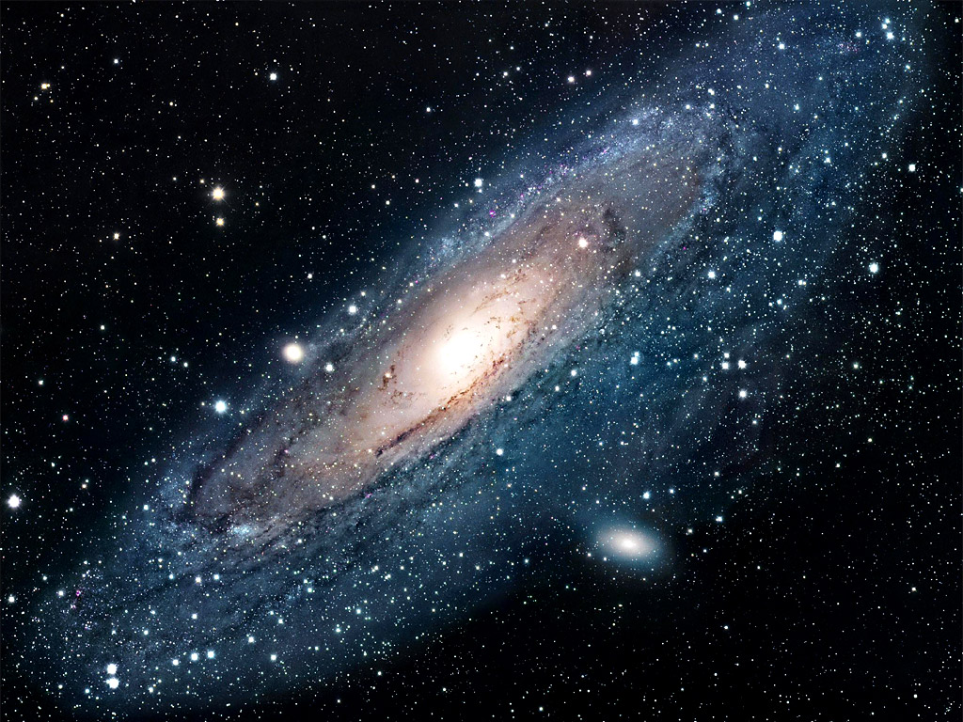
Did you know...
• that the Andromeda Galaxy has 200,000,000,000 stars?
That’s a lot of stars!

Slide 3
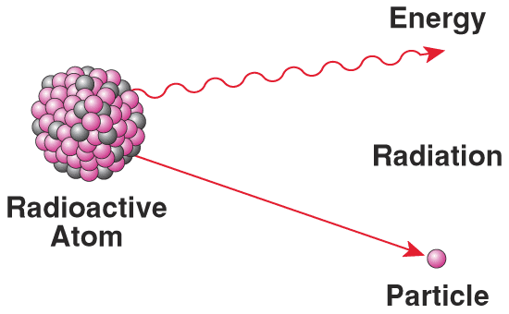
Or did you know...
• that a radioactive alpha particle is only
0.000,000,000,000,000,000,000,006,645 kilograms?
That’s small!

Slide 4
Too many zeroes!
200,000,000,000 stars
0.000,000,000,000,000,000,000,006,645 kilograms

Slide 5
Solution!! → Get crafty
with base 10!
200,000,000,000 = 2 x 100,000,000,000
= 2 x 10¹¹
2 x 10¹¹ is so much easier !!

Slide 6
Scientific Notation
Scientific Notation is:
decoding a really big or really small number into
number x 10^{something}

Slide 7
Scientific Notation
Scientific Notation is:
decoding a really big or really small number into
number x 10^{something}
The Power of 10!

Slide 8
Reviewing Base 10
10²
base exponent

Slide 9
Reviewing Base 10
10²
base exponent
10² = 10 x 10 = 100

Slide 10
Reviewing Base 10
10²
base exponent
10² = 10 x 10 = 100
10⁻³ = 1/10 x 1/10 x 1/10 = 0.001

Slide 11
So….
Positive exponents….make numbers larger
→ the decimal moves RIGHT.
10² = 100 1 .
Negative exponents…make numbers smaller
→ the decimals moves LEFT.
10⁻³ = 0.001 . 1
*Note: 10² = 1 x 10² …right? Right!

Slide 12
Reviewing Base 10
Simple way to remember.
1) Start with ‘1.0’
2) +exponent = move decimal right
3) –exponent = move decimal left.
4) Decimal moves same # as exponent.
ie: 10³ → 1.0 Fill in the spots with
(= 1 x10³ ) ‘0’
= 1000 !

Slide 13
Reviewing Base 10
Try:
10⁻⁵
1.0 = 0.00001

Slide 14
You Try…
10⁴ =
10⁶ =
10⁻² =
10¹ =
10⁻⁵ =
10⁰ =

Slide 15
You Try…and check
10⁴ = 10,000
10⁶ = 1,000,000
10⁻² = 0.01
10¹ = 10
10⁻⁵ = 0.00001
10⁰ = 1

Slide 16
Scientific Notation
Now…instead of 1 x 10^{something} , we have a different number in front of base 10.
So we need to factor.
ie: 345 = 3.45 x 100

Slide 17
Scientific Notation
Now…instead of 1 x 10^{something} , we have a different number in front of base 10.
So we need to factor.
ie: 345 = 3.45 x 100
= 3.45 x 10²

Slide 18
Now Factoring…
In Scientific Notation, we like the first number to have a decimal between the 1st and 2nd digit. That’s just the way it is. The second number is a base 10.
So…
12,309 = 1.2309 x 10,000

Slide 19
Now Factoring…
In Scientific Notation, we like the first number to have a decimal between the 1st and 2nd digit. That’s just the way it is. The second number is a base 10.
So…
12,309 = 1.2309 x 10,000
= 1.2309 x 10⁴

Slide 20
Now Factoring…
In Scientific Notation, we like the first number to have a decimal between the 1st and 2nd digit. That’s just the way it is. The second number is a base 10.
So…
12,309 = 1.2309 x 10,000
= 1.2309 x 10⁴
This is Scientific Notation!!

Slide 21
Converting to Scientific Notation
A short cut….
3499 = ? Start by putting the decimal where
it needs to be.
3.499 x 10?

Slide 22
Converting to Scientific Notation
A short cut….
3499 = ? Start by putting the decimal where
it needs to be.
3.499 x 10?
Now figure out which way the decimal needs to move (right = +, left = - ) and how far to get to original number. In this case, decimal needs to move right 3 spaces. So…it’s 3.499 x 10³

Slide 23
You try…
378 =
304,622 =
0.00707 =
0.085 =

Slide 24
You try…and check
378 = 3.78 x 10²
304,622 = 3.04622 x 10⁵
0.00707 = 7.07 x 10⁻³
0.085 = 8.5 x 10⁻²

Slide 25
Scientific Notation → standard form
1) Same as before except start with the number given.
2) +exponent = move decimal right
3) – exponent = move decimal left.
4) Decimal moves same # as exponent.
ie: 3.33 x 10⁻³ = 0.00333

Slide 26
You try putting into standard form
4.3 x 10² =
7.79 x 10⁻¹ =
6.09 x 10⁴ =
1.234 x 10⁻⁵ =

Slide 27
…and check….
4.3 x 10² = 430
7.79 x 10⁻¹ = 0.779
6.09 x 10⁴ = 60,900
1.234 x 10⁻⁵ = 0.00001234

Slide 28
So now you know!!
Remember that alpha particle that has a mass of
0.000,000,000,000,000,000,000,006,645 kilograms?

Slide 29
So now you know!!
We can say it’s 6.645 x 10⁻²⁴ kg.
Much easier!!

Slide 30
Check Your Understanding Assignment
Click HERE to be directed to a short quiz on Scientific Notation.
NOTE: You must use your school Google Account to be able to take the quiz.
You are able to go back and review the PowerPoint at anytime during the quiz.

