Slide 1
Solutions and Solubility
Aqueous Solutions and Their Properties

Slide 2
What is a Solution?
Solution – homogeneous mixture made of two main parts.
Solvent – substance present in largest amount. The substance doing the dissolving
Solute – other substances in the solution. The substance being dissolved.
Aqueous solution – solution with water as the solvent

Slide 3
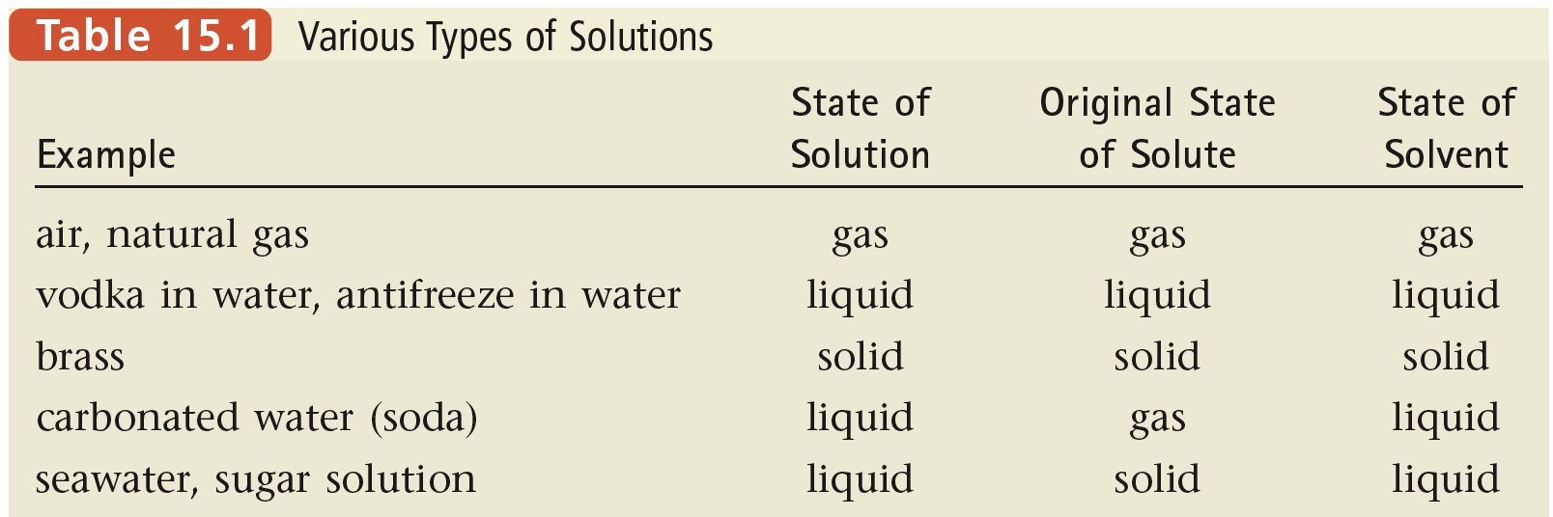
Various Types of Solutions
State of Solvent | State of Solute | Example
Liquid | Liquid
Liquid | Solid
Liquid | Gas
Gas | Gas
Solid | Solid

Slide 4
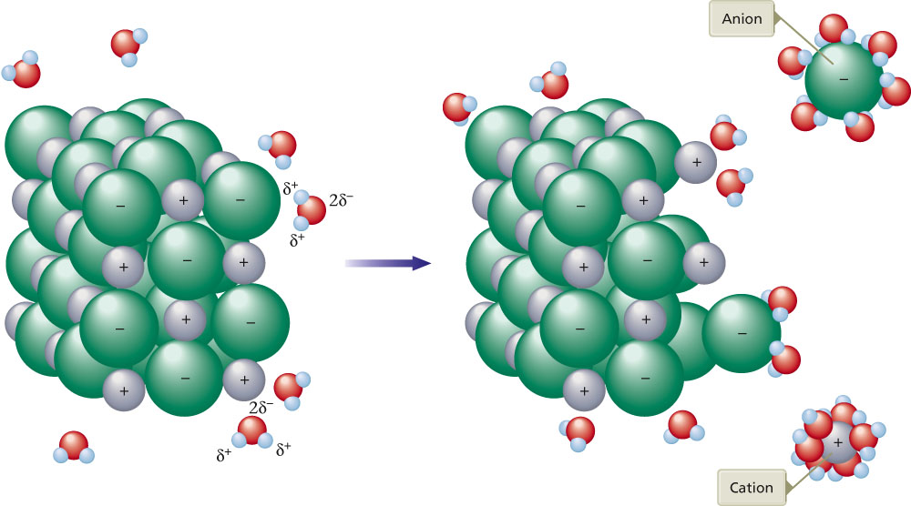
Review: Solubility of Ionic Substances
Polar water molecules interact with the positive and negative ions of a salt. (like dissolve like)

Slide 5
Review: Solubility of Ionic Substances
Ionic substances breakup into individual cations and anions. The process is called dissociation.
Dissociation Equation: A reaction equation showing the ions present when an ionic compound dissolves

Slide 6
Write dissociation equation for the following ionic compounds
sodium carbonate
potassium phosphate
aluminum chlorate

Slide 7
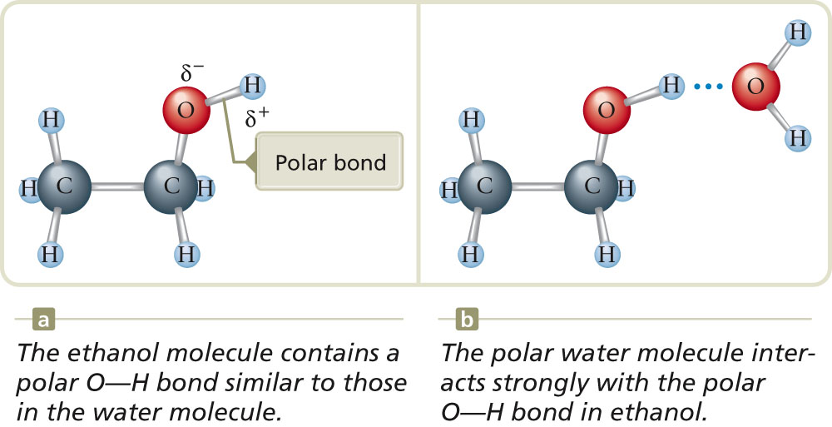
Review: Solubility of Polar Substances
Ethanol is soluble in water because of the polar -OH bond. (like dissolves like)

Slide 8
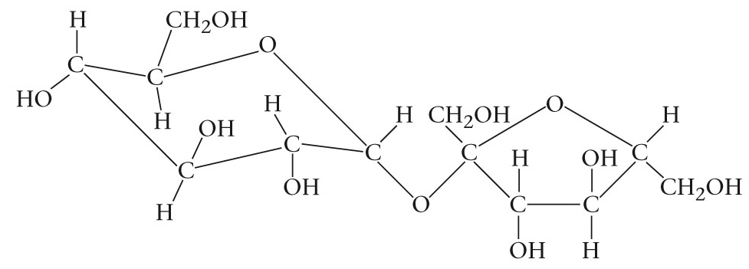
Review: Solubility of Polar Substances
Why is solid sugar soluble in water?
Plenty of polar –OH bonds for water to bond with.

Slide 9
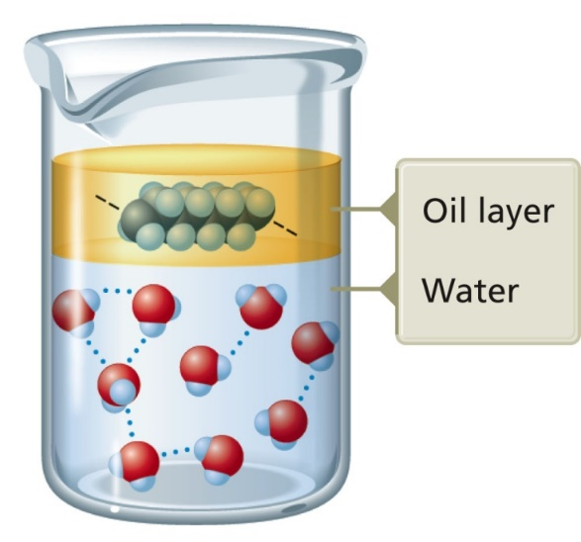
Substances Insoluble in Water
Substances that are unable to bond with water (polar molecule) are not soluble.
Nonpolar oil does not interact with polar water.
Water-water hydrogen bonds keep the water from mixing with the nonpolar molecules.
These are also said to be immiscible

Slide 10
How Substances Dissolve Tyler DeWitt

Slide 11
Dissolving Summary
The intermolecular bonds between solute particles must be broken.
A “hole” must be made in the water structure for each solute particle.
The lost water-water interactions must be replaced by water-solute interactions.
“like dissolves like”

Slide 12
Homework
Read sections 8.2, 8.3
Page 389 #2,3,6
Take the Check Your Understanding Quiz

