Slide 1
Static Electricity

Slide 2
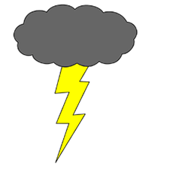
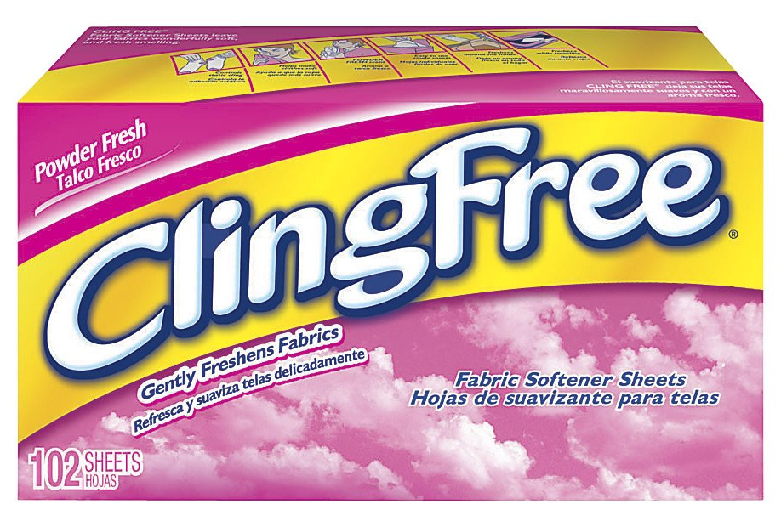
Static Electricity
Accumulates on an object to form an electric charge
Charges are static = stationary
Static electricity does NOT move through wires.
Examples:
During thunderstorms – Lighting
When we empty the dryer – static cling

Slide 3
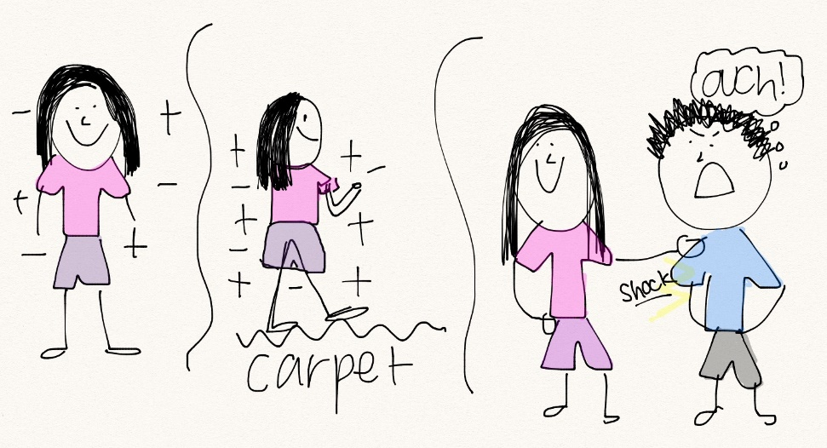
When different materials are rubbed together or bump into each other a lot, ELECTRONS leave one surface and collect on the other (transfer)
Examples:
water droplets in a thunderstorm with high winds
Socks rubbing against a carpet

Slide 4
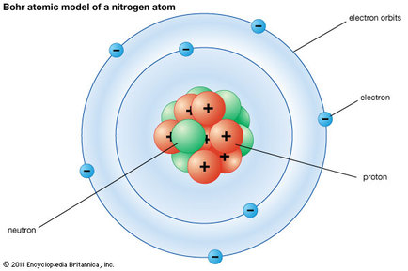
Electron Theory
Matter is made up of ATOMS
Recall: 2 types of charges: POSITIVE and NEGATIVE
Each atom has a positive NUCLEUS made up of PROTONS and NEUTRONS that is surrounded by negative ELECTRONS
Neutrons have NO charge
The OUTER electrons can MOVE around within the substance

Slide 5
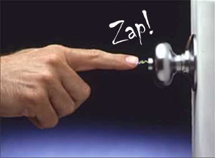
Electron Transfer
Some materials gain electrons and end up with a NEGATIVE charge
Some materials lose electrons and end up with a POSITIVE charge
When a CHARGED object has more electrons than it can hold on to, they are suddenly released, creating a SPARK

Slide 6
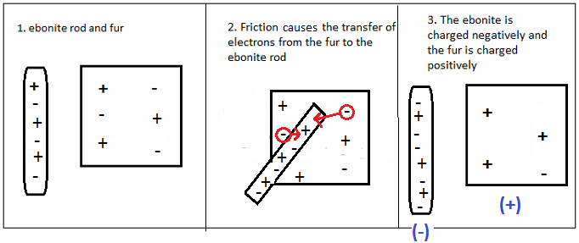
Ebonite and Fur

Slide 7
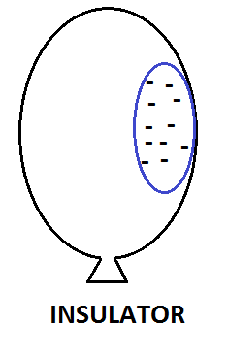
There are 2 kinds of materials:
Insulators
-If you rub an object, and the charge stays on the spot where you rubbed, the material is called an insulator

Slide 8
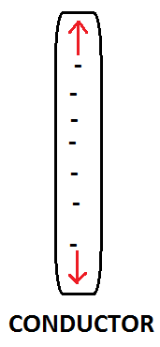
2. Conductors
If the charges moves freely across or through the material, it is called a conductor
Most metals are conductors.
They DO NOT hold a static charge.

Slide 9
Insulators →Conductors

Slide 10
The Law of Electric Charges
Most objects are neutral (uncharged) because they have the same number of positive and negative charges
The Law of Electric Charges states that:
Like charges repel
Opposite charges attract
A neutral object attracts bother positively and negatively charged objects

Slide 11
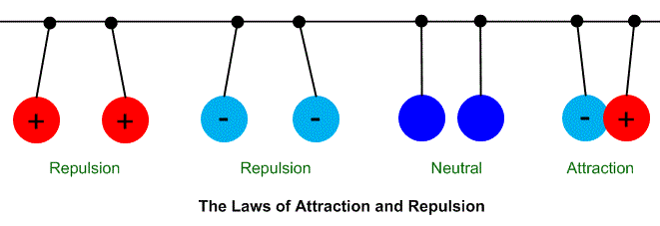
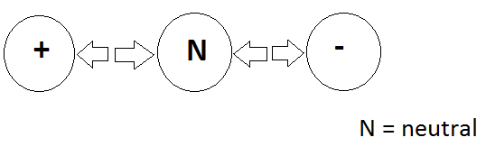

Slide 12
Assigned Work
Watch and complete the Bill Nye video questions
Fill out the note that goes with this powerpoint.
Take the Check Your Understanding – Static Electricity Quiz

