Slide 1
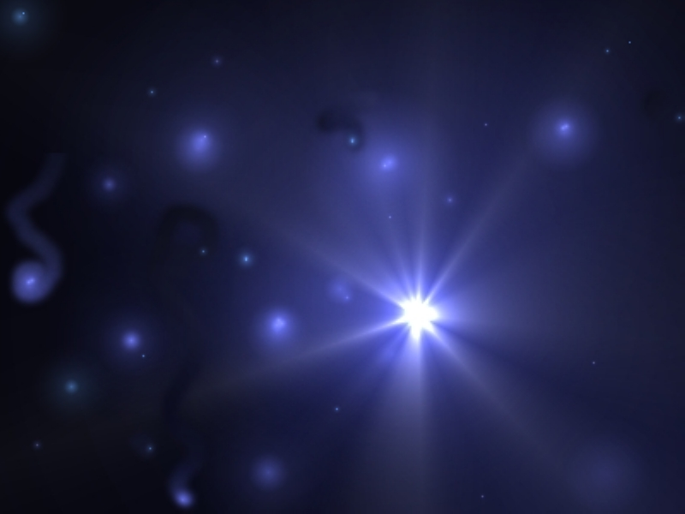
What do we see in the Night Sky…
Download SkyView Lite from the App Store or Google Play (free version)

Slide 2
A. Stars organized into Patterns
Consider the shape of the sky like an upside-down bowl – the rim of the bowl is the horizon. This model is called the celestial sphere.

Slide 3
If you watch the stars for a whole night they appear to move from east to west (as sun does during day). But the stars are not actually moving across the celestial sphere – Earth’s rotation causes the illusion of movement.
The stars appear to rotate around a single point in the sky – the North Star – Polaris - which seems to stay fixed in place while others move around it.

Slide 4
How to find Polaris?
We can use constellations – patterns formed by other stars
Polaris is the last star in the handle of Ursa Minor (Little Bear), Little Dipper. Use the SkyView Lite app to locate Polaris tonight. (face North)

Slide 5
Constellations that circle around Polaris are called circumpolar because they travel around the pole star. They are always visible in Canada. How many can you see on a clear night, use the app.

Slide 6
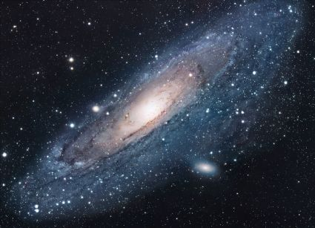
B. Celestial Object of the Universe
Everything that exists, including celestial objects such as stars and planets as well as all the matter and empty space surrounding them is the Universe.

Slide 7
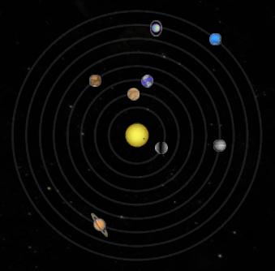
Solar System
Sun’s gravity exerts a powerful pulling force on the planets.
This gravitational pull is a force of attraction that keeps the planets moving in a circular pattern around it.
The circular pattern is called an orbit.

Slide 8
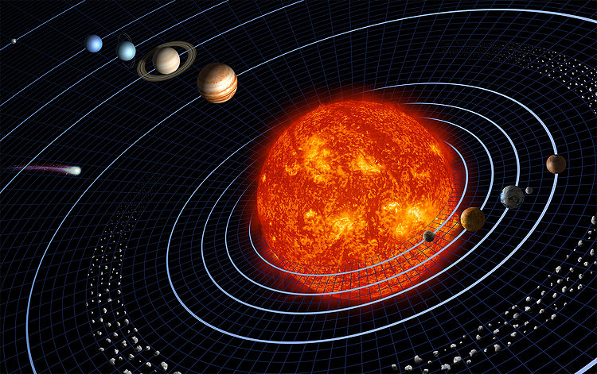
Planets revolve around the Sun which means that they move in an orbit around the sun.
Most planets also have moons that orbit around them.
The sun, planets, moon, and other objects that orbit the sun make up the solar system.

Slide 9
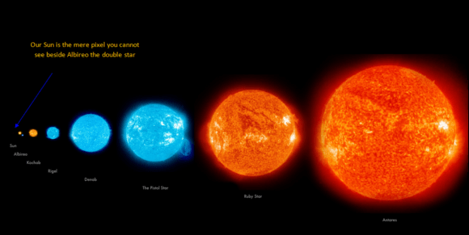
Stars
A star is a ball-shaped mass of superheated gases that produces and gives off light, heat, and other kinds of energy.
Our Sun is a star.
Stars vary in size, colour, temperature and density.

Slide 10
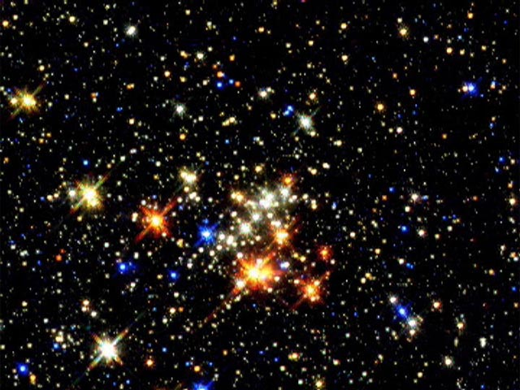
How can we measure distances in space?

Slide 11
Galaxies
A collection of many billions of stars held together by gravity is called a galaxy.
There are billions and billions of galaxies in the universe.
Our solar system is located in the Milky Way galaxy.

Slide 12
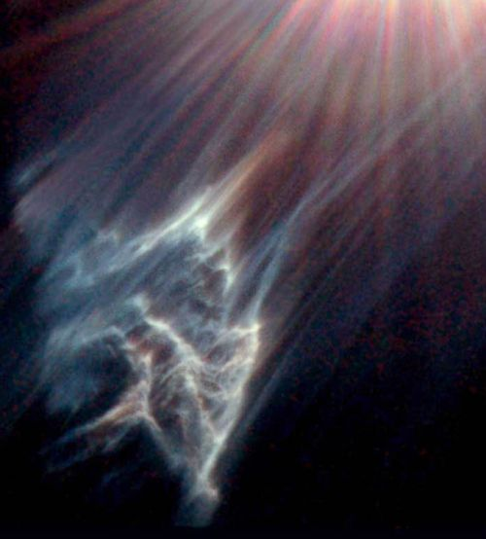
Galaxies also contain masses of gas and dust.
The gas is mainly hydrogen atoms.
Space dust is made up of atoms and fragments of atoms.
Most of a galaxy is nothing – just empty space!

Slide 13
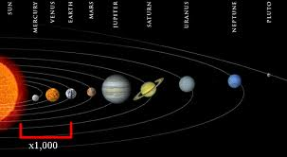
C. Object separated by immense distances
The distances in space are so immense, using standard distance units does not make sense.
Astronomers have created their own units to measure distances in space.

Slide 14
One astronomical unit (AU) is equal to the distance between the Sun and Earth (150 000 000 km).

Slide 15
The distance from the Sun to Neptune is 30 AU
The distance from the Sun to Mercury is 0.39 AU

Slide 16
The distance between stars and galaxies is too great to be covered in a human lifetime. AUs are not sufficient.
A light-year is the distance that light travels in one year.
Light travels at a speed of 300 000 km/s
One light year covers 9.5 trillion km.
Most stars and galaxies are hundreds, thousands and even millions of light-years away!

Slide 17
What is the best unit to measure the following?
your home to school
m or km
2. your home to Kingston
km
3. Canada to Saturn
AU
4. the Sun to Polaris
light years

Slide 18
Distances from the Sun – A Relative Scale
Planet | Distance (km) | Distance (AU) | Toilet Paper Squares
Mercury | 58,000,000 | 0.387 | 2.0
Venus | 108,000,000 | 0.723 | 3.7
Earth | 150,000,000 | 1.0 | 5.1
Mars | 228,000,000 | 1.524 | 7.7
Jupiter | 778,000,000 | 5.203 | 26.0
Saturn | 1,427,000,000 | 9.529 | 48.4
Uranus | 2,870,000,000 | 19.19 | 97.3
Neptune | 4,497,000,000 | 30.06 | 152.5

Slide 19
Homework
Using the SkyView Lite app, or a star map, try to identify at least 3 constellations.
Visit the following website to see what you can see during June.
https://www.space.com/16149-night-sky.html

