Slide 1
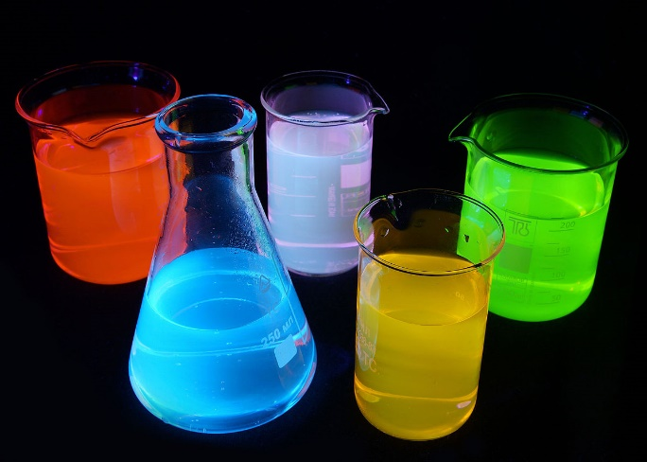
Solubility and Concentrations

Slide 2
Solutions are classified as mixtures.
The amounts of substances mixed (solute and solvent) can vary in different solutions.
Concentration is a way of communicating how much solute is dissolved into a given amount of solution.
Qualitatively, concentrations can be referred to as:
concentrated – relatively large amount of solute (concentrated orange juice)
dilute – relatively small amount of solute

Slide 3
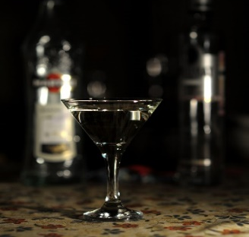
Solubility – the maximum amount of substance that can dissolve into a given amount of solvent at a particular temperature. Refers to the amount of solute required to produce a saturated solution.
For example, at room temperature, white sugar has a solubility of about 200 grams per 100 milliliters of water and table salt about 35 grams/100 milliliters.
Unsaturated solution – the solution has not reached the limit of solute that will dissolve.
Some solute/solvent pairing do not have a limit and can mix in any proportion. These are said to be miscible.
For example, ethanol and water.

Slide 4
Supersaturated solution – more than the maximum amount of solute dissolved into a given amount of solvent at a given temperature.
Can be created by making a saturated solution at an elevated temperature and then allowing the solution to cool. (solubility tends to increase with increased temperature)
Supersaturated solutions are unstable and excess solute can ‘crash out’ by bumping the solution or adding a crystal to causes precipitation.

Slide 5
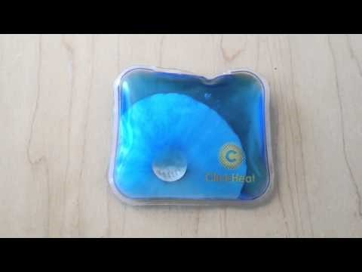
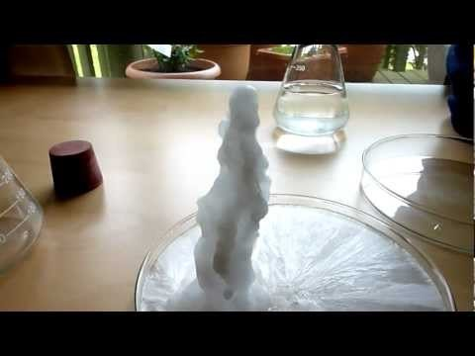
Supersaturated Solutions
Sodium Acetate – Hot Ice
Hot Pad – Supersaturated solution
Here’s a link to try it at home

Slide 6
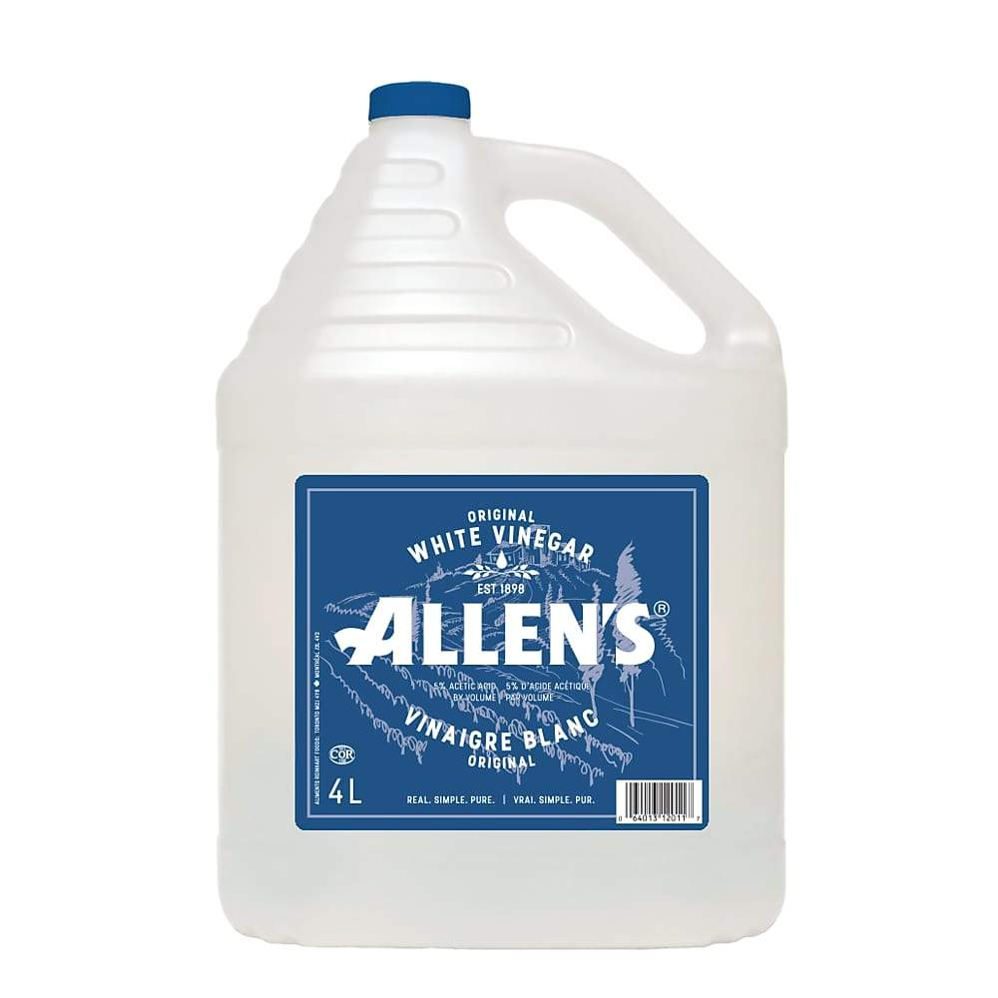
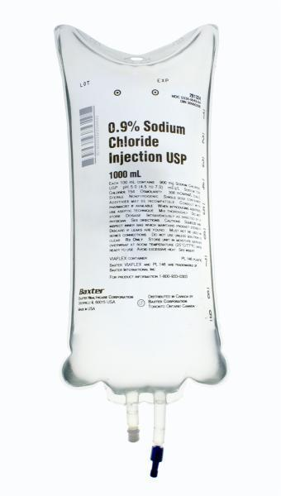
Quantitative Measures of Concentration
In the consumer world, most solution concentrations are communicated as a percentage
% Concentration = amount of solute x 100
amount of solution
A typical bottle of vinegar is a 5% solution of acetic acid, meaning that there are 5ml of pure acetic acid dissolved in a total volume of 100ml of solution (solute + solvent)
[a volume/volume %]
A typical IV solution is a 0.9% solution of sodium chloride, meaning that there is 0.9g of pure sodium chloride dissolved into 100ml of solution.
[a weight/volume %]

Slide 7
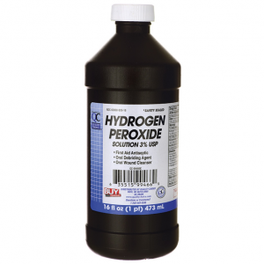
Commercially sold antiseptic solution contains 7.5 g of hydrogen peroxide in every 250 mL bottle. Determine the percent weight by volume concentration.
c_{w/v%} = 3.0%

Slide 8
Extremely Low Concentrations
Hematologists, water quality analysts and environmental scientists are often required to measure very small quantities of solute in solution
Water Testing
Heavy metals, such as lead and mercury
Blood Tests
monitoring glucose levels for diabetics
Parts per million (ppm)
Just as per cent means out of a hundred, so parts per million or ppm means out of a million.
Describes the concentration of something in water or soil.
One ppm is equivalent to 1 milligram of something per litre of water (mg/l) or 1 milligram of something per kilogram soil (mg/kg).

Slide 9
Dissolved oxygen is important in determining the health of aquatic ecosystems. Determine the concentration of oxygen, in ppm, if a 250 mL sample of water contains 2.2 mg of oxygen.
8.8ppm

Slide 10
Time to Practice
Page 408 #1,2
Page 410 #1

Slide 11
Quantitative Measures of Concentration
In the Chemistry world, we prefer to know how many particles there are in a solution.
The preferred concentration measurement is Molarity (M = mol/L)
Molarity (M) = moles of solute (mol) C = n volume of solution (L) V
If you have 1.00 mol of sugar dissolved into water to make 125.0 mL solution. Calculate the molar concentration of this solution.
8.00 mol/L or 8.00 mol L-1 or 8.00 M

Slide 12
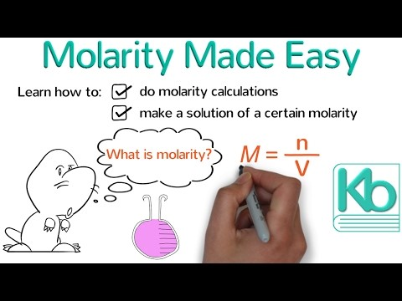
Molarity Calculations Made Easy - Ketzbook

Slide 13
Let’s try this one…
A 500.0-g sample of potassium phosphate is dissolved in enough water to make 1.50 L of solution. What is the molarity of the solution?
Need the formula for potassium phosphate
K₃PO₄
Since we are looking for molar concentration (molarity) we need to convert mass → moles.
500.0 g / 212.27 g/mol = 2.35549065 mol
1.57M
Notes:
500.0 g is equivalent to 2.355 mol K₃PO₄ (500.0 g / 212.27 g/mol). The molarity is therefore 1.57 M (2.355 mol/1.50 L).

Slide 14
And one more…
Consider separate solutions of NaOH and KCl made by dissolving 100.0 g of each solute in 250.0 mL of solution. Calculate the concentration of each solution in units of molarity.
Fun fact… both solutions have the same c_{m/v%} = 40%
100.0 g NaOH / 39.998 g/mol
100.0 g KCl / 74.55 g/mol
NaOH = 10.00 M
KCl = 5.365 M
Notes:
[100.0 g NaOH / 39.998 g/mol] / [250.0 / 1000] = 10.0 M NaOH
[100.0 g KCl / 74.55 g/mol] / [250.0 / 1000] = 5.37 M KCl

Slide 15
Check Your Understanding
You have two HCl solutions, labeled Solution A and Solution B. Solution A has a greater concentration than Solution B. Which of the following statements are true?
a) If you have equal volumes of both solutions, Solution B must contain more moles of HCl.
b) If you have equal moles of HCl in both solutions, Solution B must have a greater volume.
c) To obtain equal concentrations of both solutions, you must add a certain amount of water to Solution B.
d) Adding more moles of HCl to both solutions will make them less concentrated.
Notes:
The correct answer is b. Solution B must have a greater volume to make it less concentrated than Solution A since Molarity = moles of solute/liters of solution.

Slide 16
Practice (our textbook uses the term ‘amount concentration’ when referring to molarity or molar concentration, this term is actually preferred by IUPAC)
Page 400 #1,3,4

Slide 17
Concentration of Ions in Aqueous Solutions When ionic compounds dissolve, they dissociate into their ions (break apart). The concentration of each ion can be determined by mole ratio.
For a 0.25 M CaCl₂ solution, what are the concentrations of each ion?
Start with the dissociation equation:
CaCl₂ → Ca²⁺ + 2Cl–
Apply mole ratios to the concentrations
CaCl₂ : Ca²⁺ = 1:1 = 0.25M CaCl₂ : 0.25M Ca²⁺
CaCl₂ : Cl– = 1:2 = 0.25M CaCl₂ : 0.50M Cl–

Slide 18
Now You Try
What is the molar concentration of the anion in a 0.50M solution of aluminum chlorate?
What is aluminum chlorate? Al(ClO₃)₃
Write out the dissociation equation:
Al(ClO₃)₃ → Al³⁺ + 3 ClO₃¹⁻
Apply mole ratio of 1:3
[ClO₃1- ]= 1.5M

Slide 19
Dilution
The process of adding more solvent (usually water) to a concentrated or stock solution to lower the concentration to the desired molarity.
Dilution with water does not alter the numbers of moles of solute present, it only increases the volume of the solution therefore decreasing the solution concentration.
Moles of solute before dilution = Moles of solute after dilution
C₁V₁ = C₂V₂

Slide 20
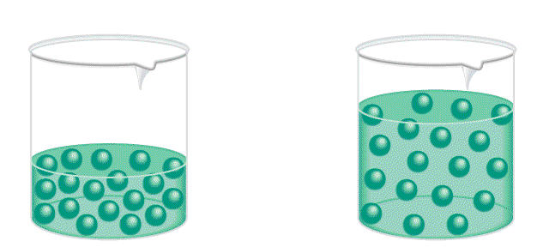
The Process of Dilution is the procedure for preparing a less concentrated solution from a more concentrated solution.
Dilution
Add Solvent
Moles of solute
before dilution
=
Moles of solute
after dilution
Since n=CV
C₁V₁
=
C₂V₂
4.5

Slide 21
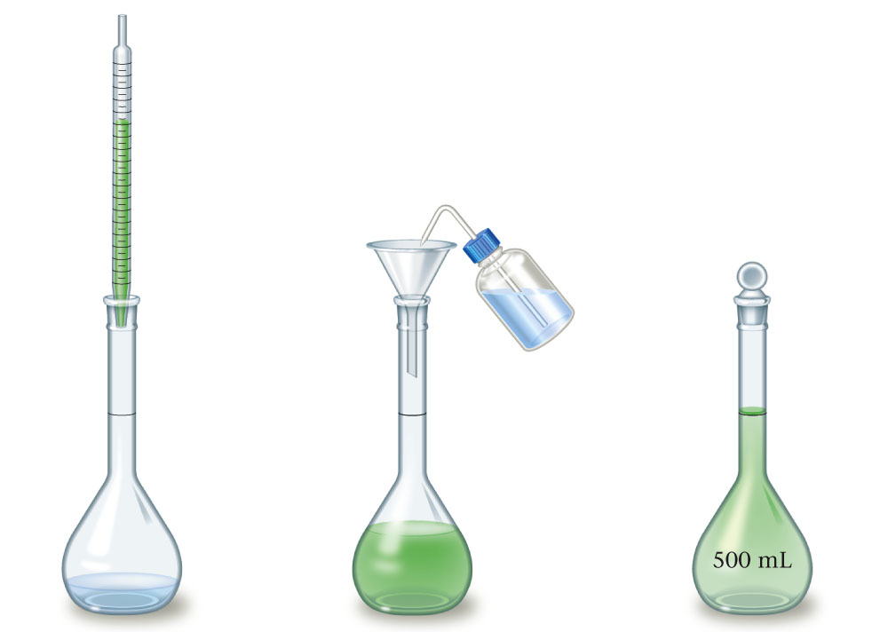
Diluting a Solution
Transfer a measured amount of original solution to a volumetric flask containing some water.
Add water to the volumetric flask to the mark (with swirling) and mix by inverting the flask.

Slide 22
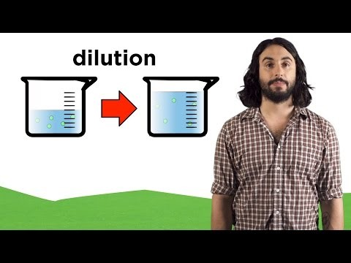
Molarity and Dilution – Professor Dave
Professor Dave incorrectly defines Molarity as moles of solute per volume of solvent (should be per volume of solution)

Slide 23
Check Your Understanding
A 0.50 M solution of sodium chloride in an open beaker sits on a lab bench. Which of the following would decrease the concentration of the salt solution?
Add water to the solution.
Pour some of the solution down the sink drain.
c) Add more sodium chloride to the solution.
d) Let the solution sit out in the open air for a couple of days.
e) At least two of the above would decrease the concentration of the salt solution.
Notes:
For letter a), adding water to the solution will increase the total volume of solution and therefore decrease the concentration. For letter b), pouring some of the solution down the drain will not change the concentration of the salt solution remaining. For letter c), adding more sodium chloride to the solution will increase the number of moles of salt ions and therefore increase the concentration. For letter d), water will evaporate from the solution and decrease the total volume of solution and therefore increase the concentration. Therefore, since only letter a) would decrease the concentration, letter e) cannot be correct.

Slide 24
Let try one…
What volume of a 2.00 M NaOH solution must be diluted to make 150.0 mL of a 0.800 M NaOH solution?
C₁V₁ = C₂V₂
(2.00 M)(V₁) = (0.800 M)(150.0 mL)
60.0 mL
Notes:
The minimum volume needed is 60.0 mL. M₁V₁ = M₂V₂ (2.00 M)(V₁) = (0.800 M)(150.0 mL)

Slide 25
Homework
Read Sections 8.6, 8.7
Page 404 #1-4
Take the Check You Understanding Quiz

