Slide 1
Electrostatic Series
Complete the note that goes with this PowerPoint

Slide 2
Electrostatic Series
It is a list of the ability of substances to hold on to their electrons
It can be used to determine which substances will get a negative charge and which will get a positive charge when rubbed together.
If electrons are lost → positive charge
If electrons are gained → negative charge

Slide 3
Material
acetate
glass
wool
cat's fur, human hair
calcium, magnesium, lead
silk
aluminum, zinc
cotton
paraffin wax
ebonite (vinylite)
polyethylene (plastic)
carbon, copper, nickel
rubber
paper
sulphur
platinum, gold
WEAK
(at holding electrons)
Increasing
Tendency to
Gain electrons
STRONG
(at holding electrons)

Slide 4
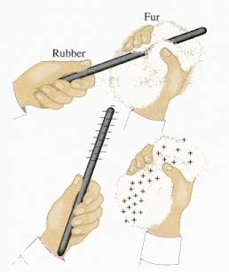
Increasing ability to hold electrons
When rubbed together, the substance that is closer to the bottom will become NEGATIVE, the one closer to the top will become POSITIVE
Try the questions on the note page before proceeding to the next slide.

Slide 5
What would be the result of…
Rubbing paper with fur?
Paper will become negative
Fur will become positive
Rubbing a plastic bag with glass?
Plastic will become negative
Glass will become positive
Rubbing a sheep on a tire?
Sheep (wool) will become positive
Tire (rubber) will become negative
Rubbing a plastic comb with fur?
Plastic will become negative
Fur will become positive

Slide 6
Assigned Work
Complete the Check Your Understanding – Electrostatic Series Quiz

