Slide 1
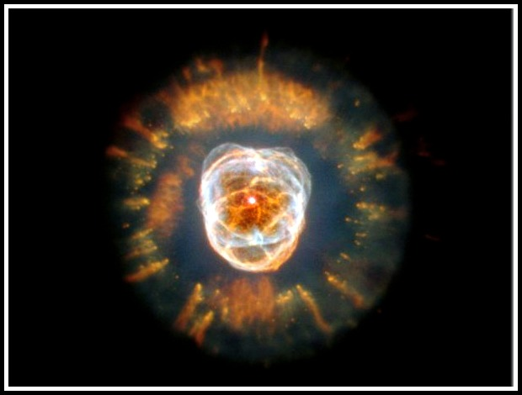
How Did it all Begin?...
The Origin of the Universe
& Solar System
Big Bang Theory - BNL

Slide 2
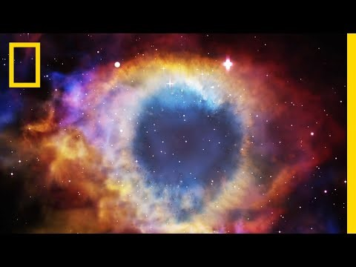
The Origin of the Universe The Big Bang Theory
“Time zero” → 10 to 15 Billion years ago
all matter was compacted into a teeny tiny little ball
little ball was extremely hot, dense and under enormous pressure
small, dense ball exploded hurling matter and energy in all directions

Slide 3
The Origin of the Universe The Big Bang Theory
Support for the theory:
cosmic microwave background radiation (the heat or “glow” left over from the explosion) (video link)
Red shift (video link)

Slide 4
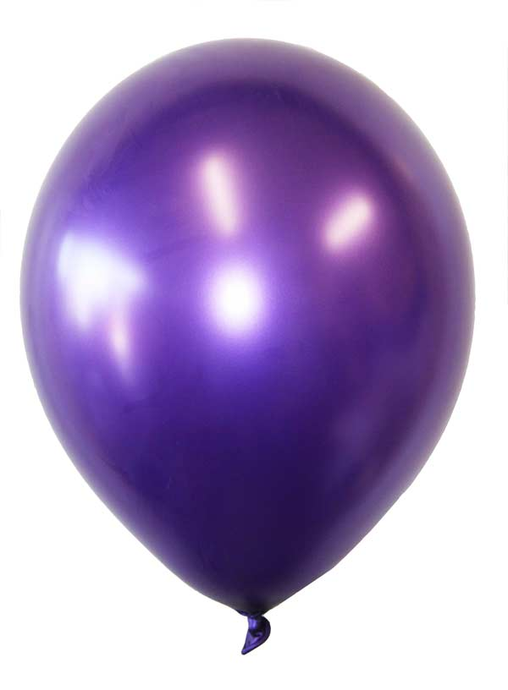
An Expanding Universe
If you have a new, deflated balloon at home try this demo/experiment.
Take a marker and draw a few random dots on the surface of the balloon.
Measure the distance between dots.
Add some air to the balloon and re-measure the distance between dots.
Add more air and re-measure, repeat a couple more times until you see a pattern.
As a balloon expands…
… so does the universe!

Slide 5
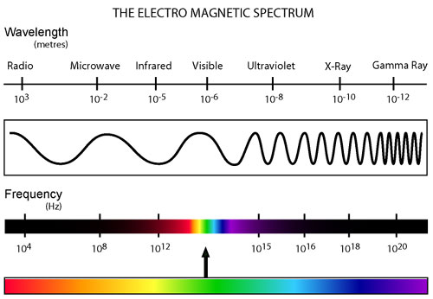
How do we know??
Galaxies produce a stream of light just as stars do. Yet when we observe different galaxies, the spectrum is not the same as we would expect.
As the galaxy moves away, the wavelength of light gets longer and shifts to the red end of the visible spectrum. This is called red-shift.

Slide 6
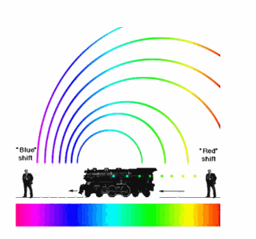
How do we know??
It means that all galaxies are moving away from us. If fact, the farthest galaxies are moving away the fastest. This means the whole universe is expanding, just like the dots on the balloon
Supports the Big Bang theory of universe formation
Will it continue to expand? Or will it stop and contract to a BIG CRUNCH??

Slide 7
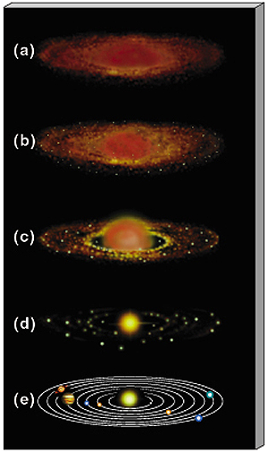
The Origin of the Solar System The Nebula Theory
Formed from a nebula (an enormous cloud of dust and gas)
The sun like all stars was formed from a nebula
Gravity causes the matter of the nebula to contract and spin
The contracting nebula begins to flatten into a spinning pancake shape with a bulge at the center. This bulge became the Sun.
Some of the cooler material also clumped together because of gravity to form the planets.

Slide 8
Homework…
Watch your favorite episode of The Big Bang Theory and have a fantastic Summer under the Stars!!

