Slide 1
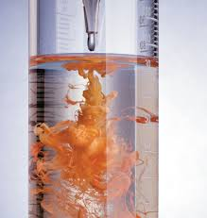
Reactions in Aqueous Solutions

Slide 2
General Properties of Aqueous Solutions
Solution - a homogeneous mixture comprised of 2 or more parts.
Solute: the component that is dissolved ‏
Solvent: the component that does the dissolving
Generally, the component present in the greatest quantity is considered to be the solvent. Aqueous solutions are those in which water is the solvent.

Slide 3
Electrolytes and Nonelectrolytes
Electrolyte: substance that dissolved in water produces a solution that conducts electricity
Contains ions
Nonelectrolyte: substance that dissolved in water produces a solution that does not conduct electricity
Does not contain ions

Slide 4
Dissociation vs Ionization
Dissociation - ionic compounds separate into constituent ions when dissolved in solution
Ionization - formation of ions by molecular compounds when dissolved (acids and some bases)

Slide 5
Precipitation Reactions
Precipitation occurs when aqueous solutions are mixed and an insoluble product forms
Solubility is the maximum amount of a solid that can dissolve in a given amount of solvent at a specified temperature
Prediction based on solubility rules
(found on page 424 or the handout provided in unit 2)

Slide 6
Identify the Precipitate
Pb(NO₃)₂(aq) + NaI(aq) → +
PbI₂
NaNO₃
(s)
(aq)

Slide 7
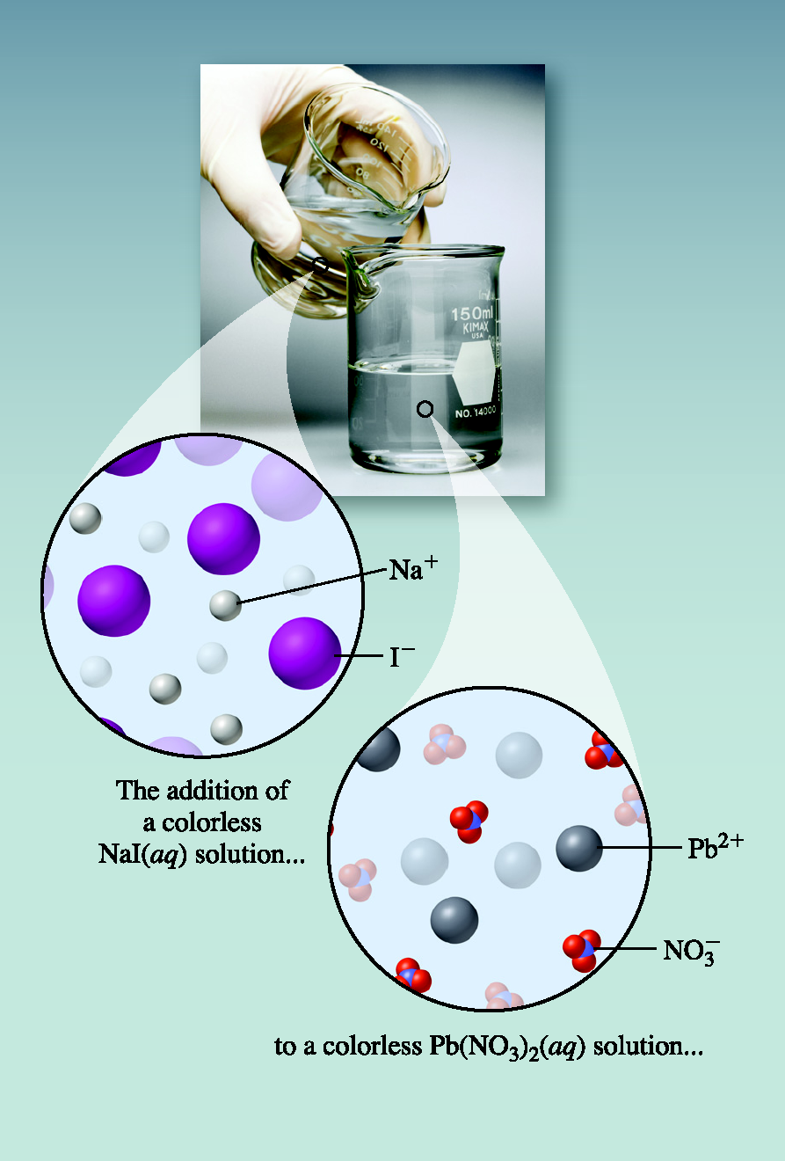
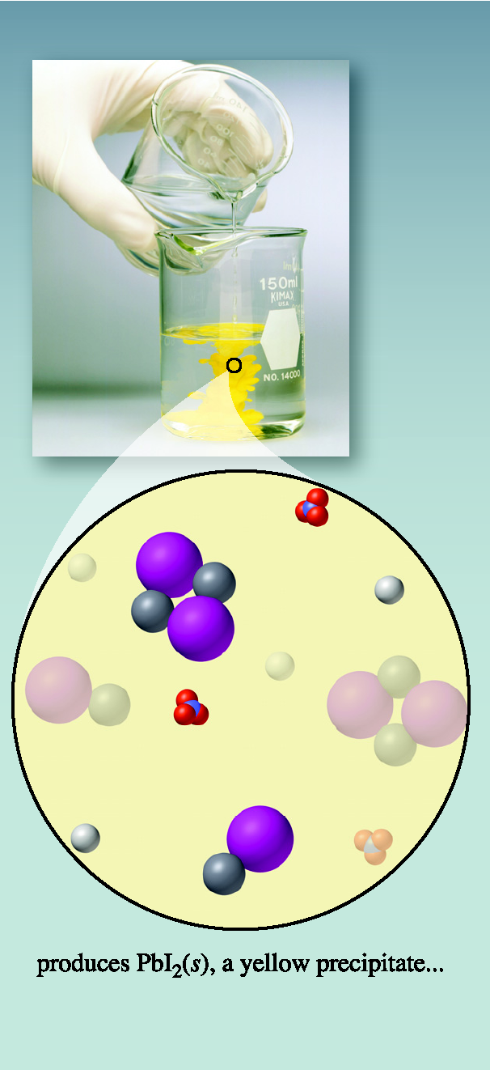
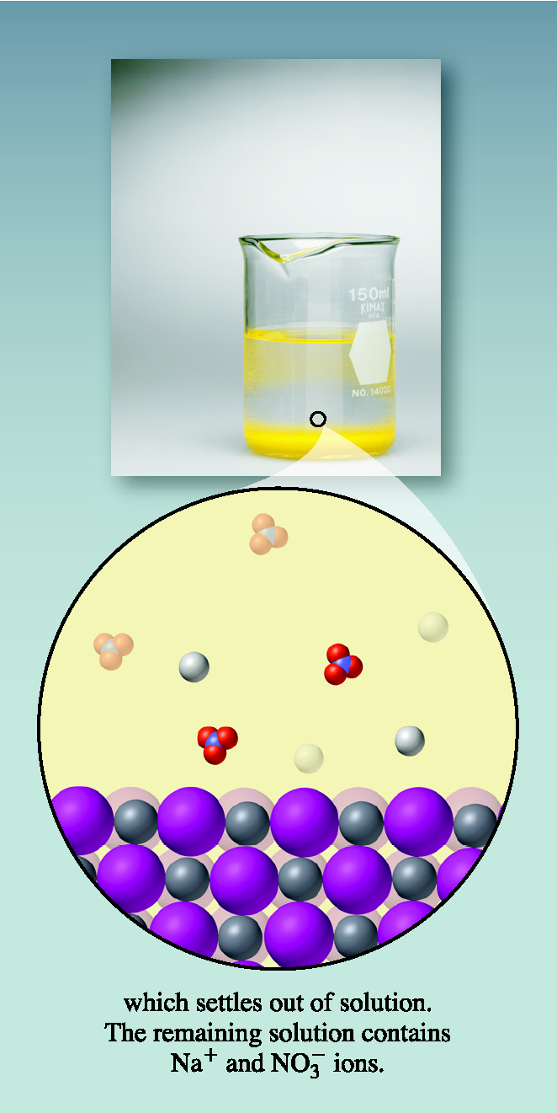
Mixing Solutions of Pb(NO₃)₂ and NaI

Slide 8
Practice with the Solubility Table
Classify the following as soluble or insoluble in water
Ba(NO₃)₂
soluble
AgI
insoluble
Mg(OH)₂
insoluble

Slide 9
Types of Reaction Equations
Formula equation: shows all compounds represented by their chemical formulas
Ionic equation: shows all strong electrolytes as ions and all other substances by their chemical formulas

Slide 10
Net Ionic Equations
Formula equation:
Ionic equation:
Eliminates spectator ions – unchanged from reactant to product
Net Ionic equation: shows only the reacting species in the chemical equation

Slide 11
Steps in writing net ionic equations
Write the balanced formula equation.
Predict products by exchanging cations and anions in reactants and include states of products.
Separate strong electrolytes (aq) into ions.
Cancel spectator ions.
Use the remaining species to write the net ionic equation.

Slide 12
Aqueous solutions of silver nitrate and sodium sulphate are mixed.
Write the net ionic equation.
Step 1: Write out the balanced formula equation.
AgNO_{3 (aq)} + Na₂SO_{4 (aq)} →
2
NaNO₃
+
Ag₂SO₄
2
(aq)
(s)

Slide 13
Aqueous solutions of silver nitrate and sodium sulphate are mixed.
Step 2: Dissociate all electrolytes (aqueous compounds). Leave solid compounds together.
2Ag⁺ _{(aq)} + 2NO₃⁻ _{(aq)} + 2Na⁺ _{(aq)} + SO₄²⁻ _{(aq)} → 2Na⁺ _{(aq)} + 2NO₃⁻ _{(aq)} + Ag₂SO_{4 (s)}
2AgNO_{3 (aq)} + Na₂SO_{4 (aq)} → 2NaNO_{3(aq)} + Ag₂SO_{4(s)}

Slide 14
Aqueous solutions of silver nitrate and sodium sulphate are mixed.
Step 3: Cancel spectators
2Ag⁺ _{(aq)} + 2NO₃⁻ _{(aq)} + 2Na⁺ _{(aq)} + SO₄²⁻ _{(aq)}→ 2Na⁺ _{(aq)} + 2NO₃⁻ _{(aq)} + Ag₂SO_{4 (s)}
Step 4: Write the net ionic reaction
2Ag⁺ _{(aq)} + SO₄²⁻ _{(aq)} → Ag₂SO_{4 (s)}

Slide 15
Time to Practice
Page 427 #1,2

Slide 16
Assignment
Please access the assignment in the Activity Feed for today. I will also put a link in the Chat box. Complete and put into the drop box before 12:30.

