Slide 1
Charging an Object
Complete the note that goes with this PowerPoint

Slide 2
Recall
Object that has an excess of electrons = NEGATIVE
Object that has lost electrons = POSITIVE
Object that has the same # of protons and electrons = NEUTRAL

Slide 3
Methods of Charging Objects
3 ways of transferring electric charges:
Friction (rubbing together)
Contact (touching)
Induction (coming close)

Slide 4
1. Charging by Friction
Objects made of different types of matter are rubbed together; this produces a static net charge on each object because electrons are transferred during the process.
Recall: Electrostatic Series
Matter that has a stronger hold on electrons will gain electrons and become negative
Matter that has a weaker hold on electrons will lose electrons and become positive

Slide 5
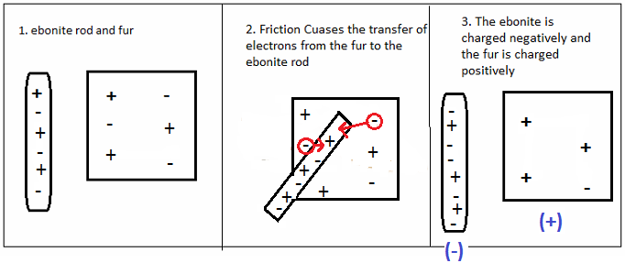
Recall

Slide 6
2. Charging by Contact
Charging by contact happens when a charged object touches a neutral object.
Electrons will move in attempts to balance the charges (spread out) – thus will move towards the object that has the least number of electons
This happens quickly - can be surprising or painful
It can even “jump” the gap prior to full contact
The result is an electric shock!

Slide 7
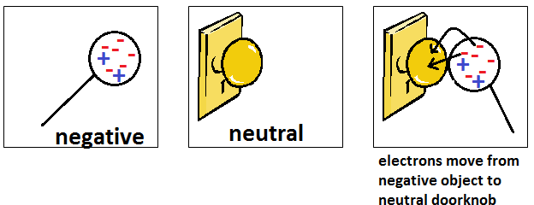
The charged object acquires the SAME charge as the originally charged object that touched it; the total charge is shared and therefore reduced.

Slide 8
3. Charging by Induction
A charged object can transfer a charge to a neutral object without touching it.
Only conductors can be charged in the induction process
The presence of the charged object forces the electrons of neutral object to move.

Slide 9
If the charging object is negative, the electrons repel.
If the charging object is positive, the electrons attract.
The result: separation of an induced charge.
If there is a ground, electrons can move into or out of the object being charged - the balance is changed and the object is now charged
*The induced object obtains an OPPOSITE charge to original charged object.*

Slide 10
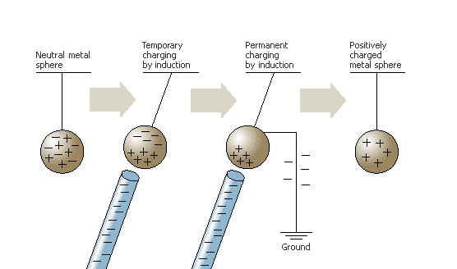

Slide 11
Assigned Work
Watch the linked video (summary of today lesson)
Complete the Check Your Understanding – Charging an Object

