Slide 1
QUALITATIVE CHEMICAL ANALYSIS
No numbers or calculations ☺

Slide 2
Qualitative Analysis
A qualitative characteristic is a description of something that does not involve numbers or units of measurement.
We will try to identify a substances using characteristic such as colour and solubility.

Slide 3
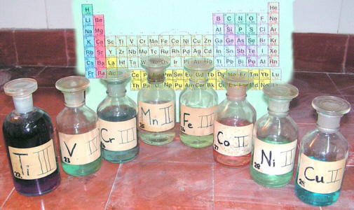
Ion Colour
The colour of substances can sometimes be used to identify ions or compounds within the substance.
See page 665 and/or the solubility table handout (left column)

Slide 4
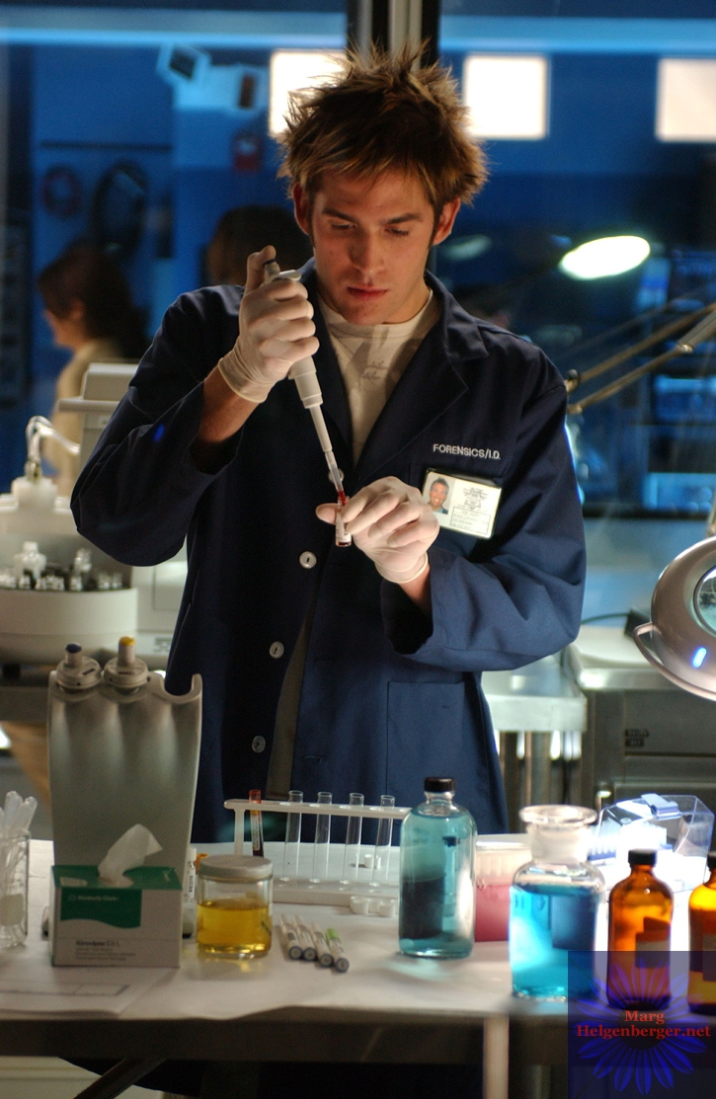
CHEMISTRY CSI
You can also use the solubility rules to determine the presence of certain ions in a solution .
Mix your sample that contains the suspected ion with a solution that contains an ion that will form a precipitate with your suspect ion.
Take advantage of the net ionic equation.
Take out you solubility table

Slide 5
EXAMPLE 1
Lets say you suspect your water sample has acetate in it. What could you do?
If you combine your water sample with a solution that contains silver ions (Ag⁺) a precipitate will form.
silver acetate will form which is insoluble – meaning it will form a precipitate.
Ag⁺_{(aq)} + C₂H₃O₂⁻_{(aq)} → AgC₂H₃O₂ _{(s)}

Slide 6
THE BIG PROBLEM
The major issue that has to be dealt with is that most solutions or samples contain more than one type of ion so chemists must design test procedures to identify and remove any suspected ions one at a time…
You need to find a solution that will react (form a precipitate) with only one of the ions at a time.

Slide 7
EXAMPLE 2
Lets say we suspect a solution has both iron (Fe²⁺) and strontium (Sr²⁺) ions in it.
Solubility rules say that hydroxide ions (OH⁻) will react with the iron ions (Fe²⁺) and form a precipitate but will not have the same reaction with strontium ions.
We could also use a solution containing sulphate (SO₄²⁻)since it will react with the strontium and not the iron.
Fe²⁺_{(aq)} + OH⁻_{(aq)} → Fe(OH)_{2(s)}
Sr²⁺_{(aq)} + SO₄⁻²_{(aq)} → SrSO_{4(s)}

Slide 8
EXAMPLE 2…Part 2
To remove the compound from the solution we will filter the solution with the precipitate. The solid compound will be trapped by the filter paper.
The solution passing through the filter paper is called the filtrate and will contain the unreacted ions. We keep this for further testing.

Slide 9
EXAMPLE 2…Part 3
Now we have the filtrate with the unreacted ions in it…how do we test for the ions?
As before use the appropriate ion to cause precipitation.

Slide 10
Problem Solving Process

Slide 11
Practice Problem
How would you determine if a solution contains ions of silver Ag¹⁺ _{(aq)} and/or ions of zinc, Zn²⁺ _{(aq)} ?
halides X¹⁻ sulphate SO₄²⁻ and acetate C₂H₃O₂ ¹⁻ ions precipitate silver but not zinc.
Add a source of either ion, if a precipitate forms the solution contained silver ions. If no precipitate forms, silver ions were not present.
Ag¹⁺_{(aq)} + Cl¹⁻_{(aq)}→ AgCl_{(s)}
Filter out the solid if a positive test.

Slide 12
Practice Problem Cont.
Find an ion that will precipitate out Zn²⁺_{(aq)}
Any ion from the bottom of the solubility table will precipitate out Zn²⁺_{(aq)} ie. hydroxide ions OH¹⁻_{(aq)}
Add a source of the ion and check for precipitation.
ppt = ion present, no ppt = ion not present.
Zn²⁺_{(aq)} + 2OH¹⁻_{(aq)} → Zn(OH)_{2(s)}

Slide 13
Problem Solving Process

Slide 14
Practice
Devise a method to determine if a solution contains the following ions.
strontium and/or manganese²⁺
copper⁺¹ and/or iron³⁺
hydroxide and/or acetate

Slide 15
Practice Time
Read section 9.3
Page 441 #3, 5, 7, 9

