Slide 1
Day 4 – Solution Stoichiometry

Slide 2
Review: Steps for Solving Stoichiometric Problems
Write the balanced equation for the reaction.
List the given and required information under the compound they refer to.
Convert the given information to moles n=m/M n=MV
*Determine which reactant is limiting if applies
Apply mole ratio between the given and required.
Convert the required to the appropriate measure. (grams, volume, concentration), if required m=nM M=n/V V=n/M

Slide 3
Concept Check
10.0 mL of a 0.30 M sodium phosphate solution reacts with 20.0 mL of a 0.20 M lead(II) nitrate solution (assume no volume change).
What precipitate will form?
2Na₃PO₄(aq) + 3Pb(NO₃)₂(aq) → 6NaNO₃(aq) + Pb₃(PO₄)₂(s)
What mass of precipitate will form?
0.0030 mol Na₃PO₄ and 0.0040 mol Pb(NO₃)₂ present to start (n=MV)
Pb(NO₃)₂ is the limiting reactant, therefore 0.0013 mol of Pb₃(PO₄)₂ is produced
molar mass of Pb₃(PO₄)₂ is 811.54 g/mol, 1.1 g of Pb₃(PO₄)₂ will form
1.1g Pb₃(PO₄)₂

Slide 4
A reaction between an acid and a base is called a neutralization reaction.
In the lab a titration is performed to accurately determine the equivalence point (point where there are equal moles of H⁺ and OH⁻)
In class, one of the skills we would have learned is how to perform a titration. Section 10.3 in your textbook outlines the procedure.
Here is a video on how to complete a titration
Steps to solve the stoichiometry problems are the same as before.
Part 2 of the titration video the calculations

Slide 5
What’s the Point of a Titration Again?
To find the unknown concentration of an acid or a base.
You perform the actual titration noting the volume you started with and how much volume of the titrant you added and then...
Stoichiometry! (Oh no! Not math! Anything but math!)

Slide 6
Titration Calculations: An Example
sulfuric acid (the titrand/analyte or unknown) is titrated with sodium hydroxide (the titrant) according to this equation:
H₂SO₄ (aq) + 2 NaOH (aq) → Na₂SO₄ (aq) + 2 H₂O (l)
Calculate the moles of NaOH from the titration data: molarity of the base (M_{B}) and the volume of the base (V_{B}). In other words, M_{B}V_{B} = (mol/L)(L) = mol NaOH in standard
Apply the mole ratio of NaOH to H₂SO₄ (2:1). Two moles of NaOH are required to neutralize 1 mol of H₂SO₄.
Calculate the molarity of the acid using moles of acid and V_{A,} the volume of the acid in liters. M_{A} = mol H₂SO₄ titrated/V_{A}

Slide 7
Concept Check
For the titration of sulfuric acid (H₂SO₄) with sodium hydroxide (NaOH), how many moles of sodium hydroxide would be required to neutralize 1.00 L of 0.500 M sulfuric acid?
H₂SO₄ + 2NaOH → 2H₂O + Na₂SO₄
0.500 moles of sulfuric acid is present to start n=MV
1:2 mole ratio, therefore 1.00mol of NaOH would be required
1.00 mol NaOH
Notes:
The balanced equation is: H₂SO₄ + 2NaOH → 2H₂O + Na₂SO₄. 0.500 moles of sulfuric acid is present to start. Due to the 1:2 ratio in the equation, 1.00 mol of NaOH would be required to exactly react with the sulfuric acid.
1.00 mol of sodium hydroxide would be required.

Slide 8
Titration Calculation
See page 482 Sample Problem #1
Several 10.00 mL samples of sulfuric acid solution of unknown concentration are titrated with a 0.100 mol/L solution of sodium hydroxide. (Note that the burette contains the sodium hydroxide solution.) The endpoint was determined using phenolphthalein indicator. The acceptable observations from the titration are summarized in Table 3. Use these data to determine the molarity of the acid solution. (full solution on next slide)

Slide 9
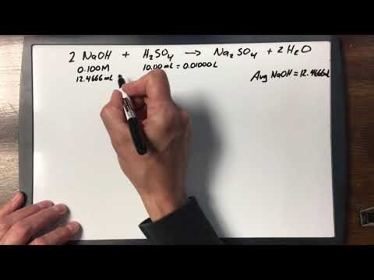
Sample Problem #1 Solution

Slide 10
Homework
Read sections 9.5 & 10.3
Page 447 #1,2
Page 484 #1-3
Take the Check Your Understanding Quiz

