Slide 1
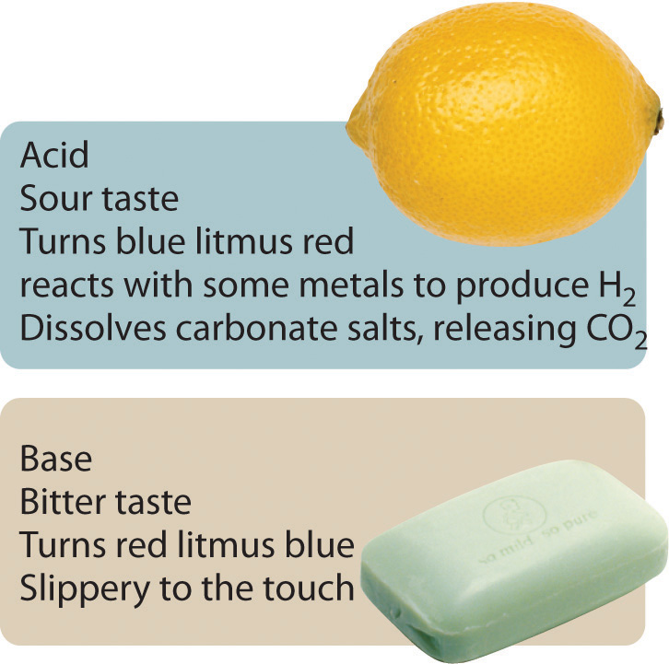
Acid and Base Properties & Definition

Slide 2
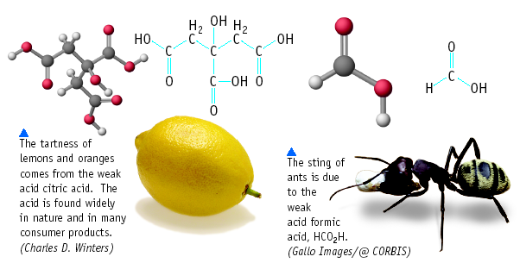
Acid and Bases

Slide 3
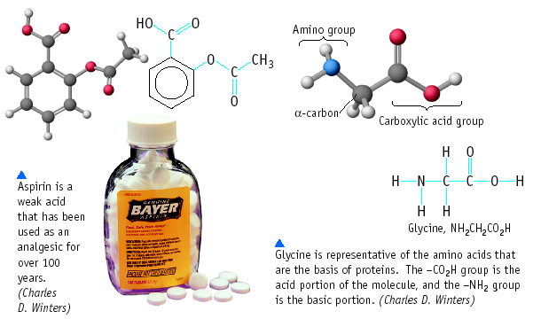
Acid and Bases

Slide 4
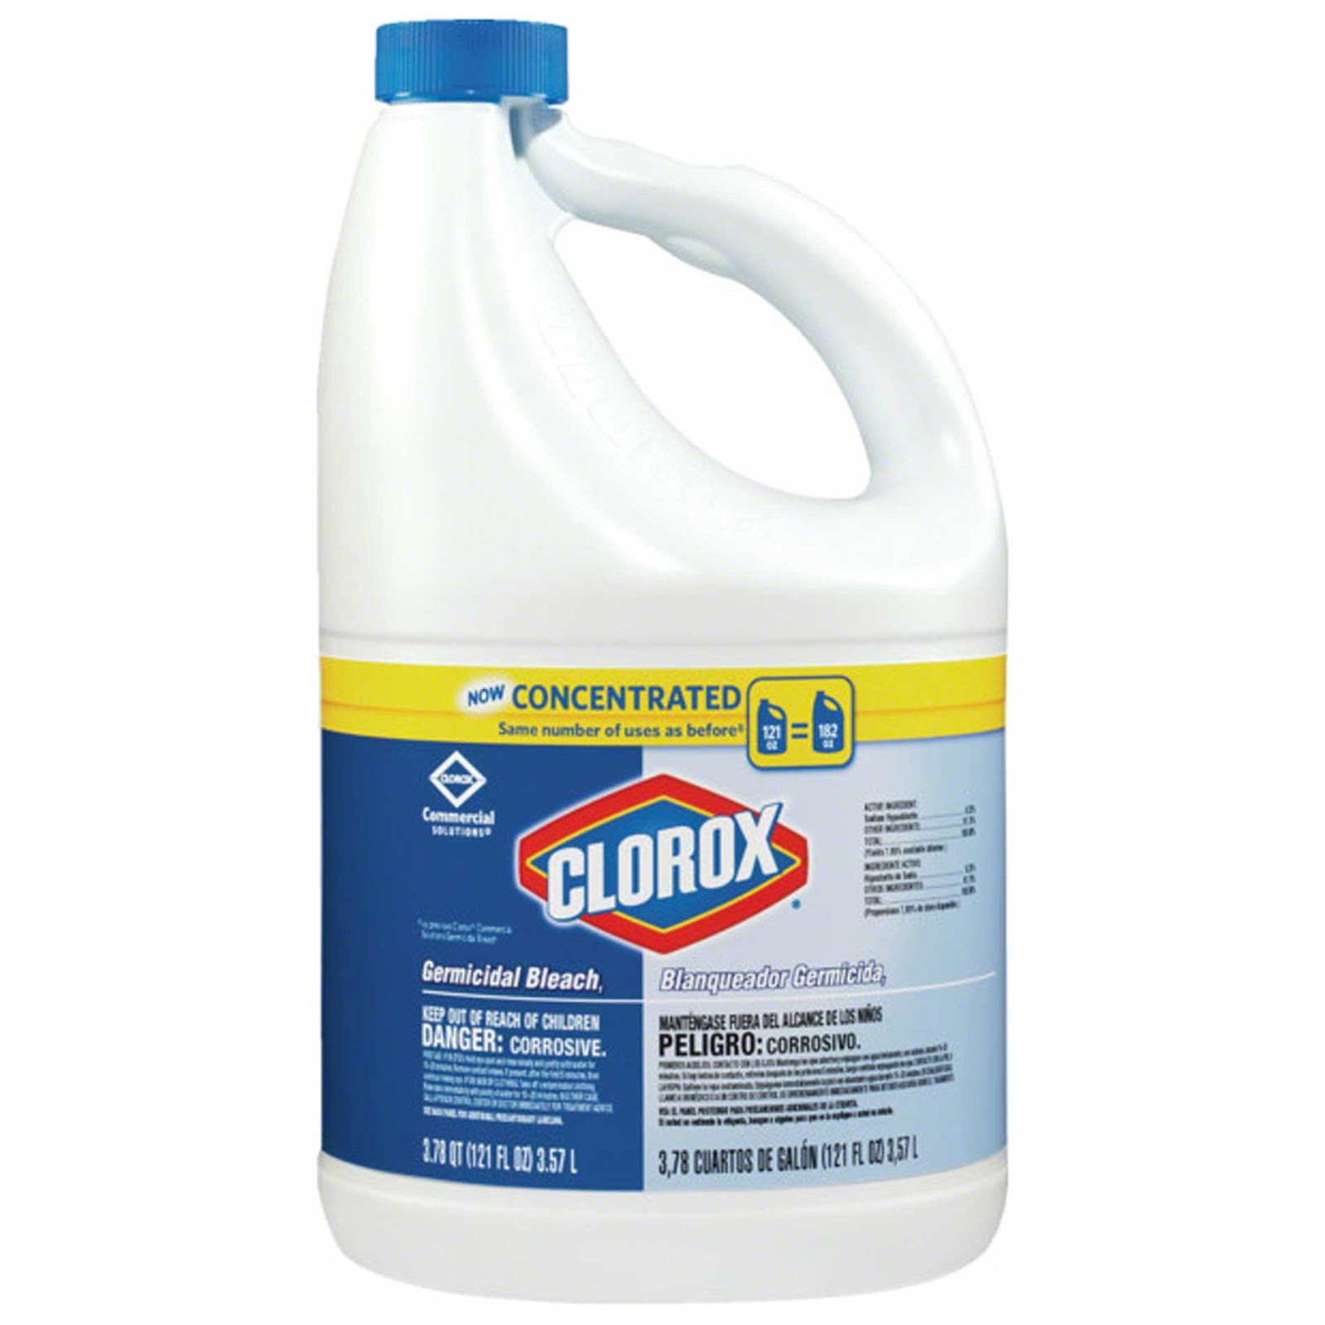
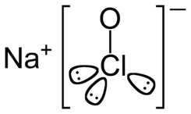
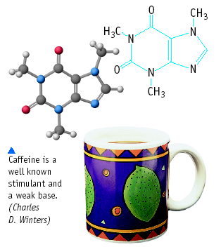
Acid and Bases

Slide 5
Some Properties of Acids
Taste sour
Corrode metals
Electrolytes (ionize in water)
React with bases to form a salt and water
pH is less than 7
Turns blue litmus paper to red “Blue to Red A-CID”

Slide 6
Acid Nomenclature Review
Binary Acids →
H plus a non-metal
Oxyacids
H plus a polyatomic ion containing oxygen

Slide 7
Acid Nomenclature Review
HI _{(aq)}
H₂CO₃
HNO₂
Try these:
Page 468 #1,2
⇒ hydroiodic acid
⇒ carbonic acid
⇒ nitrous acid

Slide 8
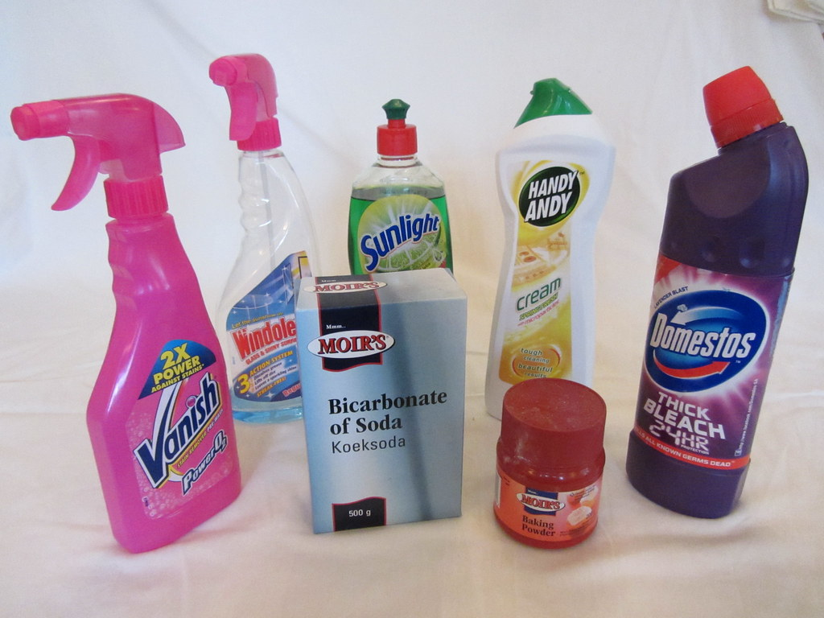
Some Properties of Bases
Taste bitter, chalky
Are electrolytes
Feel soapy, slippery
React with acids to form salts and water (neutralization)
pH greater than 7
Turns red litmus paper to blue “Basic Blue”

Slide 9
Acid/Base Definition
Definition: Arrhenius (there are actually 3 acceptable definitions of acids/bases; we will only look at the Arrhenius definition this year)
Acids – produce H⁺ ions (or hydronium ions H₃O⁺) in water
Bases – produce OH⁻ ions in water

Slide 10
Arrhenius acid is a substance that produces H⁺ (H₃O⁺) in water
Arrhenius base is a substance that produces OH⁻ in water

Slide 11
Strong and Weak Acids and Bases
The comprehension check at the end is confusing since the text and the voice over do not match (the screen text is correct)

Slide 12
Practice Time
Read Sections 10.1 and 10.2
Page 475 #3,7,12
Take the Check Your Understanding Quiz

