Slide 1
Solution Stoichiometry

Slide 2
Review: Steps for Solving Stoichiometric Problems
Write the balanced equation for the reaction.
List the given and required information under the compound they refer to.
Convert the given information to moles n=m/M n=CV
*Determine which reactant is limiting if applies
Apply mole ratio between the given and required.
Convert the required to the appropriate measure. (grams, volume, concentration), if required m=nM C=n/V V=n/C

Slide 3
Let’s Try One
10.0 mL of a 0.30M sodium phosphate solution reacts with 20.0 mL of a 0.20M lead(II) nitrate solution (assume no volume change). What mass of precipitate should form?
Start with a balanced equation:
Na₃PO₄ _{(aq)} + Pb(NO₃)_{2(aq)} →
1.1g Pb₃(PO₄)₂

Slide 4
Self Practice
Page 447 #1,2

Slide 5
Titrations
The stoichiometry of an acid-base neutralization reaction is the same as that of any other reaction that occurs in solution (they are double displacement reactions, after all).
For example, in the reaction of sodium hydroxide and hydrochloric acid, 1 mol of NaOH neutralizes 1 mol of HCl:
NaOH (aq) + HCl (aq) → NaCl (aq) + H₂O (l)
Stoichiometry provides the basis for a procedure called titration, which is used to determine the concentrations of acidic and basic solutions.

Slide 6
Titrations
In the lab, a titration is performed to gather data needed to calculate the concentration of an unknown acid or base.
In class, one of the skills we will learned is how to perform a titration. Section 10.3 in your textbook outlines the procedure. (Planned for Jan 25 & 26 when we return to class)
Once the data has been gathered, the steps to solve the stoichiometry problems are the same as before.

Slide 7
How to perform a titration

Slide 8
What’s the Point of a Titration?
To find the unknown concentration of an acid or a base.
You perform the actual titration noting the volume you started with and how much volume of the titrant you added and then...
Stoichiometry! (Oh no! Not math! Anything but math!)

Slide 9
Titration Calculations: An Example
sulfuric acid (the titrand/analyte or unknown) is titrated with sodium hydroxide (the titrant) according to this equation:
H₂SO₄ (aq) + 2 NaOH (aq) → Na₂SO₄ (aq) + 2 H₂O (l)
Calculate the moles of NaOH from the titration data: molarity of the base (M_{B}) and the volume of the base (V_{B}). In other words, C_{B}V_{B} = (mol/L)(L) = mol NaOH
Apply the mole ratio of NaOH to H₂SO₄ (2:1). Two moles of NaOH are required to neutralize 1 mol of H₂SO₄.
Calculate the molarity of the acid using moles of acid and V_{A,} the volume of the acid in litres. C_{A} = mol H₂SO₄/V_{A}

Slide 10
Titration Calculation
See page 482 Sample Problem #1
Several 10.00 mL samples of sulfuric acid solution of unknown concentration are titrated with a 0.100 mol/L solution of sodium hydroxide. (Note that the burette contains the sodium hydroxide solution.) The endpoint was determined using phenolphthalein indicator. The acceptable observations from the titration are summarized in Table 3. Use these data to determine the molarity of the acid solution.

Slide 11
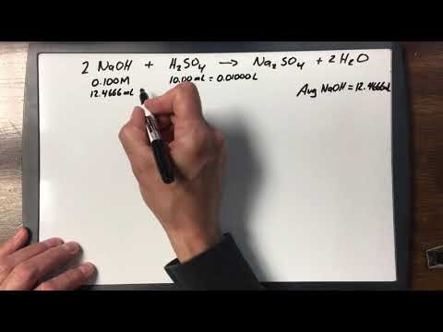
Sample Problem #1 Solution

Slide 12
Practice Time
Read sections 9.5 & 10.3
Page 484 #1-3
Take the Check Your Understanding Quiz

