Slide 1
The Mole
Molar mass – the mass of one mole of a substance

Slide 2
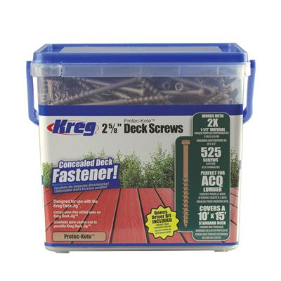
Indirect Counting
I think it’s pretty obvious that it is impossible to actually count out 1.0 mole of anything, so how do we know how many atoms or molecules are in a sample??
Have you ever bought a large box of screws for a backyard project like a deck and wondered who counted them??
They are not counted, they are weighed.
525 screws

Slide 3
Average Mass
During the manufacturing process, the screws are created such that each screw has approximately the same mass, plus or minus a small amount.
If you know the average mass of each item, the number of items can be counted by weighing out a sample.
An average #10 deck screw has a mass of 5.68g/screw.
How many deck screws would be in a 1.0kg box? (1000g)
? Screws = 1000g ÷ 5.68g/screw
= 176.056338 screws = 176 screws
Not every screw is exactly the same mass so we wouldn’t get a perfect whole number so we round off to the closest whole number.
Items can be counted if you know their average mass.

Slide 4
Counting atoms
If there was only a place where the average mass of an atom was recorded, it would make it possible for us to count atoms, if there was only a place where atoms masses were listed….
Yup, the Periodic Table.
The average atomic mass listed on the periodic table is the average mass of an atom when taking into consideration all the naturally occurring isotopes, measured in AMU.
It is also the mass of a 1.0mole sample of that element, measured in grams.
1 atom of carbon has a mass of 12.011amu
1.0 moles of carbon has a mass of 12.011grams
This relationship applies to the entire periodic table.
This is called Molar Mass (M)

Slide 5
Determine the Molar Mass
I will be using the online periodic table
What is the mass of 1.0 moles of gold?
Since gold has an average atomic mass of 196.97amu, the mass of 1.0 moles of gold is 196.97g
Which is also referred to as the molar mass of gold = 196.97g/mol
What is the molar mass of sodium?
Since sodium has an average atomic mass of 22.990amu, the molar mass of sodium is 22.990g/mol
What is the molar mass of sulphur dioxide?
First thing you will notice is that sulphur dioxide is not on the periodic table…sorta.
You need to know which atoms make up this compound before you can determine the compound’s molar mass. Watch this video.

Slide 6
Practice
Try these before we move on.
Section 6.4, Page 275 #1

Slide 7
Converting between mass and moles
If 1.0mol of carbon has a mass of 12.011g (it’s molar mass), what is the mass of 3.0mol of carbon?
?g = 3.0mol x 12.011g/mol
=36.033g
=36g (2sig figs)
Mass = moles x molar mass
m = n x M

Slide 8
Converting between mass and moles
How many moles of water are in a 452g sample of water?
You first need the molar mass of water (H₂O) = 2xM_{H} + 1xM_{O}
=2(1.008g/mol)+1(15.999g/mol)
=18.015g/mol
?moles = 452g ÷ 18.015g/mol
= 25.09020261mol
= 25.1mol (3 sig figs)
Moles = mass ÷ molar mass
n = m ÷ M

Slide 9
Mole map
N_{A} = Avogadro’s Number = 6.022 x 10²³particles/mole
CF = information from the chemical formula
M = molar mass of the compound
Today’s Focus
x CF
x N_{A}
÷ M
Smaller Particle
Particle (N)
n = N
N_{A}
n = m
M
Mole (n)
Mass (m)
÷ CF
÷ N_{A}
x M

Slide 10
Practice
Here is a video of mass→moles and moles→mass conversions
Section 6.4, Page 277 #1,2
Take the Check You Understanding Quiz

