Slide 1
Symbols for Circuit Diagrams
Online introductory video
Stop watching at 8:10
Get the note accompanying this PowerPoint and complete as you work through

Slide 2
1 Cell
source of electrical current
long bar represents positive terminal

Slide 3
3 Cell Battery
2 or more cells joined together
can also represent a power supply

Slide 4
Switch
Open switch
opened – stops flow of current
closed – allows current to flow

Slide 5
Fuse
breaks the circuit if too much current flows through that part of the circuit (safety)
metal within melts and must be replaced

Slide 6
Circuit Breaker
breaks the circuit if too much current flows through that part of the circuit (safety)
the metal inside bends when heated to open the circuit, can be reset once cools

Slide 7
Light Bulb
converts electrical energy into light energy

Slide 8
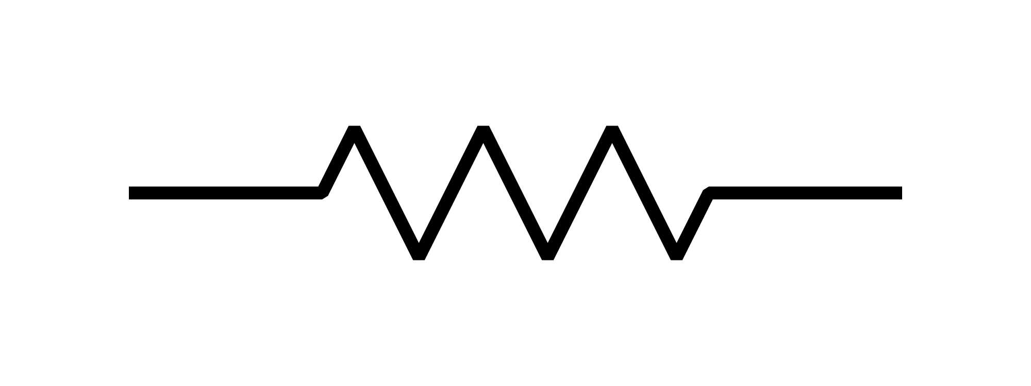
Resistor
resists the flow of current
used to change the amount of current that flows through a part of a circuit

Slide 9
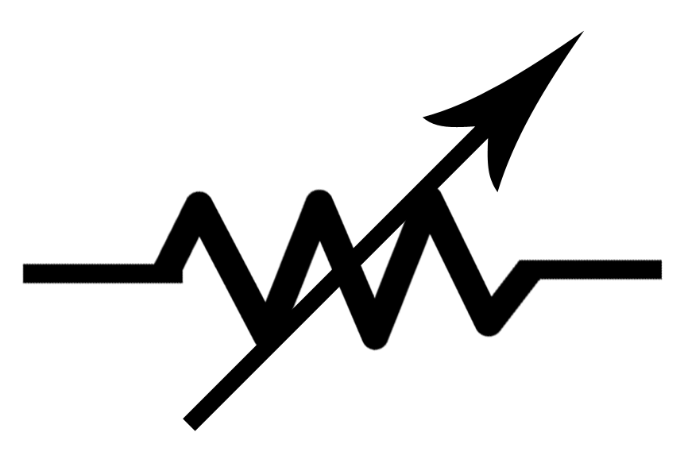
Variable Resistor (Rheostat)
variable resistance
adjustable amount of resistance which changes the amount of current through that part of the circuit
think of a volume control or a light dimmer switch

Slide 10
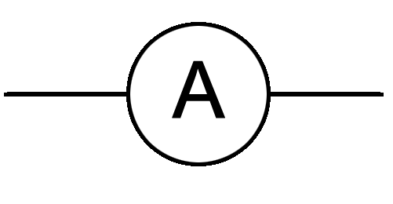
Ammeter
measures current (amperes) in a part of a circuit

Slide 11
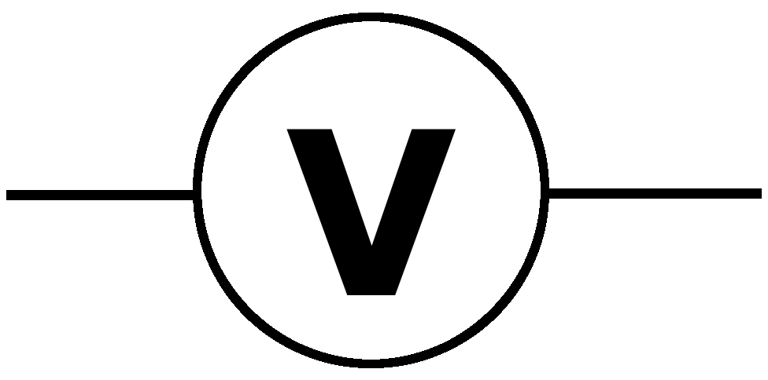
Voltmeter
measures voltage (volts) passing through an electrical energy source or load (something using electrical energy)

Slide 12
Conducting Wire
a conductor that allows electricity to flow

Slide 13
Wires Joined Wires Not Joined

Slide 14
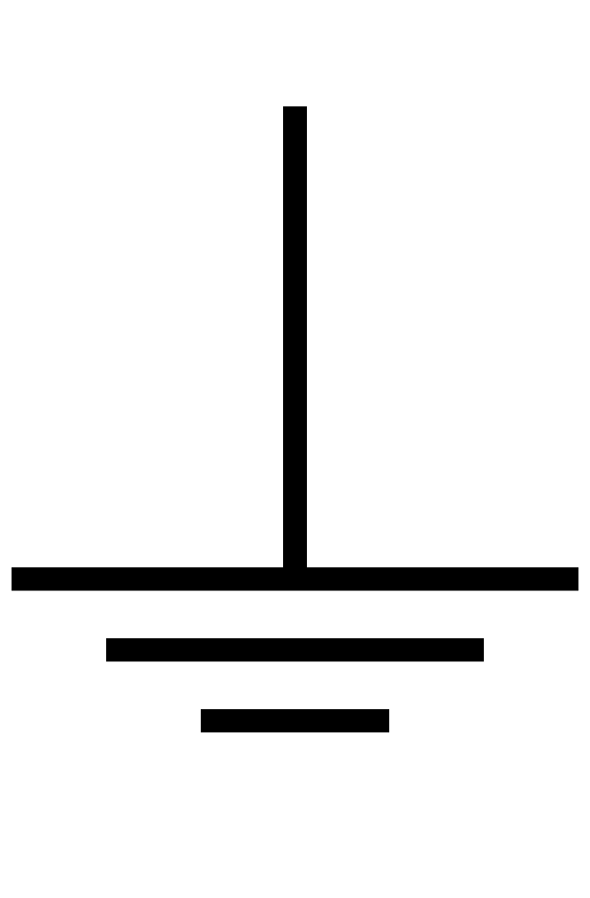
Ground Connection
connects to ground to allow discharge (safety)

Slide 15
Activity – Making a light bulb light up!
Use the PhET simulator found on the SNC1D page (click Intro). Drag and drop the equipment from the left tool bar to create a circuit such that the light bulb glows. Arrows on the tool bar will show more items. The red ends can be connected and grabbed and stretched. To disconnect a part of the circuit, click on the connection circle and ‘cut’ the connection.
When you’re done, draw your circuit using the proper symbols and answer the questions on the note.
Take the Check Your Understanding – Circuit Diagrams Quiz

