Slide 1
Electrical Current
The Flow of Electrical Energy Within a Circuit

Slide 2
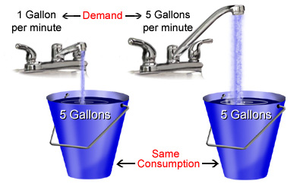
Measuring Current
The flow rate of water passing through a hose can be calculated by dividing the amount of water passing a point by the time,
flow rate = amount of water passing time

Slide 3
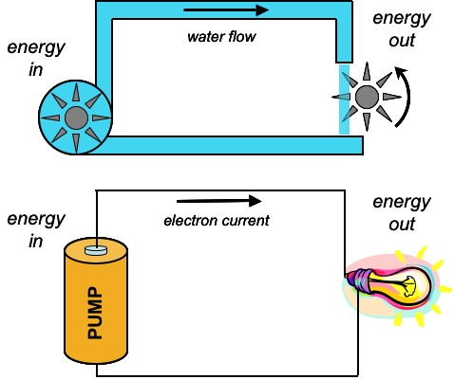
Measuring Current
Electric current is the flow rate of electrons passing through a wire. Current can be calculated by dividing the amount of charge by the time
current = charge passing a point time
I = Q
t
Each value has a symbol:
Current = I
Charge = Q
Time = t

Slide 4
Electrical Current
The unit of measure for current is the Ampere (A)
The symbol for current is I
Current is the amount of charge (or amount of electrons) that pass through a wire per unit of time (second)

Slide 5
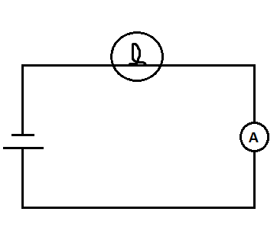
Ammeter
measures the amount of current flowing past a single point in a circuit
it is connected in series
The ammeter shows the current at this point

Slide 6
VIDEOS
TVO video:
Sorry about the quality of the graphics, if you can get past it, the content is pretty good
Electricity: Current http://www.youtube.com/watch?v=5laTkjINHrg

Slide 7
Homework
Complete the note that goes with the PowerPoint
Complete the Video Questions
Read Section 13.3 in the textbook
Take the Check Your Understanding Quiz

