Slide 1
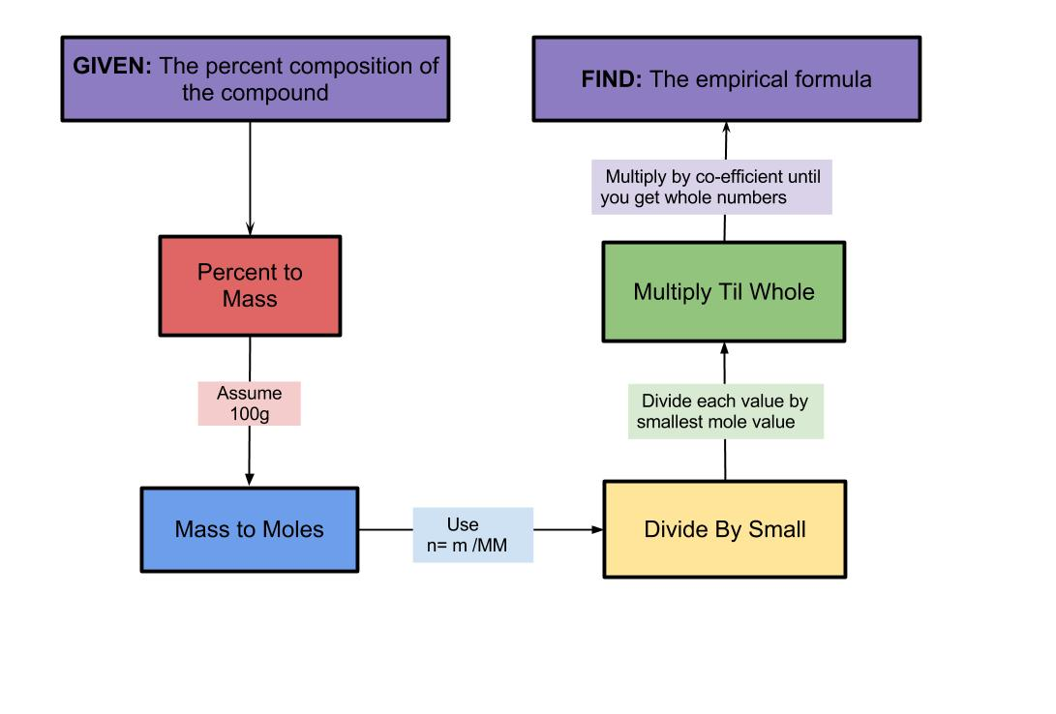
Empirical Formula

Slide 2
Empirical Formula
The empirical formula of a chemical compound is the simplest whole number ratio of atoms of each element present in a compound.
An ionic compound’s formula (also called formula units) are usually given in lowest ratios of ions and therefore technically an empirical formula.
The molecular formula identifies the actual number of each type of atom in a molecule.

Slide 3
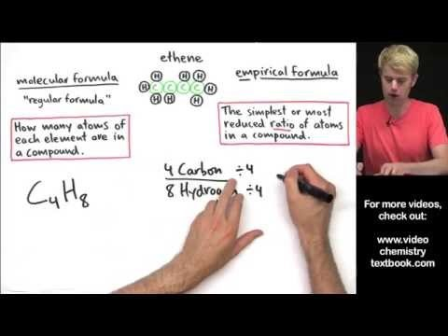
Empirical Formula vs Molecular Formula – Tyler DeWitt

Slide 4
Calculating Empirical Formula
The empirical formula can be determined experimentally.
If you are able to determine the mass of each element within a compound, the particle ratio of each element can be determined using our knowledge of mass and moles.
This is usually done using a combustion analysis as seen with % composition calculations.

Slide 5
Calculating Empirical Formula (page 290-)
Start with the number of grams of each element, given in the problem. If percentages are given, assume that the total mass is 100 grams, this easily converts the % to mass.
Convert the mass of each element to moles using the molar mass from the periodic table. n=m/M
Divide the mole value for each element by the smallest number of moles calculated.
Round to the nearest whole number if close to a whole number. This is the particle ratio of the elements and is represented by subscripts in the empirical formula.
If the number is too far to round (x.1 ~ x.9), then multiply each by a factor to convert them to whole numbers. Example: 0.5 multiply by 2, 0.25 multiply by 4, etc

Slide 6
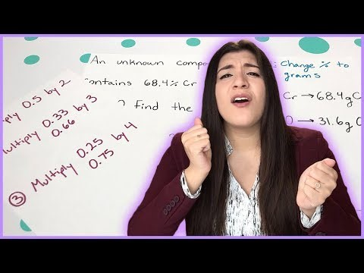
Empirical Formula Calculations – Melissa Maribel

Slide 7
Sample Problem #1
A compound was analyzed and found to contain 13.5g Ca, 10.8g O, and 0.675g H. What is the empirical formula of the compound?
Ca : O : H
13.5g : 10.8g : 0.675g
40.078g/mol : 15.999g/mol : 1.008g/mol
0.33684mol : 0.67504mol : 0.66964mol
0.33684mol
1 : 2 : 2

Slide 8
Answer

Slide 9
Sample Problem #2
NutraSweet is 57.14% C, 6.16% H, 9.52% N, and 27.18% O. Calculate the empirical formula of NutraSweet.

Slide 10
Answer
C₁₄H₁₈N₂O₅
This is the empirical formula.
What is the chemical formula for NutraSweet?
PubChem - Aspartame

Slide 11
Homework
Read section 6.7 in the textbook.
Pg 292 #1
Pg 293 #4,9
Take the Check Your Understanding Quiz

