Slide 1
Potential Difference
The push of electrons around a circuit

Slide 2
Potential Difference (Voltage)
Electrons flow through a conductor when there is a surplus of electrons at one pole of the energy source and a deficit at the other pole. The electrical potential of the two poles is different.
Although the electrons have the potential for doing work, they cannot do so until the cell is connected to a load and the circuit is closed.

Slide 3
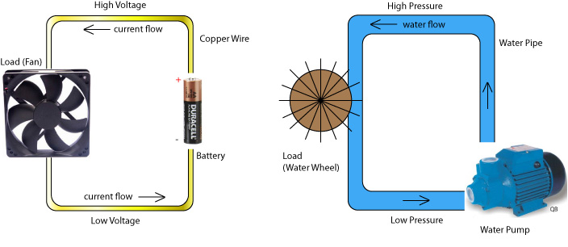
Electrical Circuit and Water Flow Comparison

Slide 4
Potential Difference (Voltage)
Potential Difference (V) – the change in energy between two points in a circuit.
It is measured with a voltmeter.
The units are volts (V)
The power supply increases the energy
The load decreases the energy

Slide 5
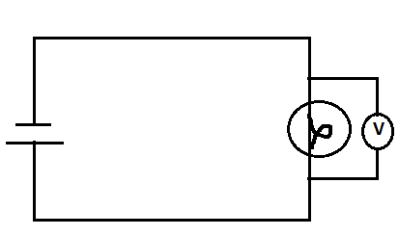
Voltmeter
measures the drop in electrical energy or “pressure” between two points in a circuit
always connected in parallel because it must read the difference between 2 points in the circuit
The voltmeter shows the drop in energy
from this point
to this point

Slide 6
VIDEOS
TVO video:
Electricity: Potential Difference http://www.youtube.com/watch?v=F1p3fgbDnkY

Slide 7
Homework
Complete the note that goes with the PowerPoint
Complete the Video Questions
Read Section 13.5 in the textbook
Take the Check Your Understanding Quiz

