Slide 1
Resistance
The Opposition to Electric Current

Slide 2
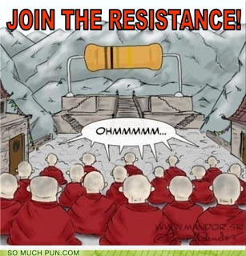
Resistance
Is the property of a substance that hinders a motion and converts electrical energy to other forms of energy, like heat, light & sound

Slide 3
Electrical Resistance
Resistors are electrical devices used in circuits to impede the flow of electrons. The greater the resistance, the more the potential drops (that is the potential difference gets bigger), as more energy is required to push a current through a wire.

Slide 4
Voltage, Current and Resistance – Bozeman Science

Slide 5
Ohm’s Law
The scientist Georg Ohm discovered this relationship while doing experiments on the resistance of wires of various sizes. It is now known as Ohm’s Law.
Resistance is measured in ohms. The symbol is (omega) Ω

Slide 6
Ohm’s Law
The resistance of a load is:
Resistance (ohms) = Potential difference across load (volts)
Current through the load (amps)
R = V usually written as
I V = IR

Slide 7
Questions
Some conductors have a very low resistance, like copper wiring in our homes. Why is this useful?
Some conductors have high resistance, like tungsten wire in a light bulb filament. Why is this useful?

Slide 8
Complete the tale
Variable Name | Formula | Unit (& symbol) | Symbol
Current
 |  |  | V
 | R = V/I | Ohms (Ω)

Slide 9
Complete the table
Variable Name | Formula | Unit (& symbol) | Symbol
Current | I = V/R | Ampere (A) | I
Potential Diff. | V = I x R | Volts (V) | V
Resistance | R = V/I | Ohms (Ω) | R

Slide 10
TVO Video
Resistance:
http://www.youtube.com/watch?v=YGvu9iqjJq4

Slide 11
TO DO
Complete the note that goes with this PowerPoint
Finish Resistance practice problems on the note
Look up Factors Affecting Resistance of a wire (textbook page 564)
Take the Check Your Understanding Quiz

