Slide 1
Stoichiometry
the quantitative study of reactants and products in a chemical reaction

Slide 2
Stoichiometry Introduction – Ketzbook

Slide 3
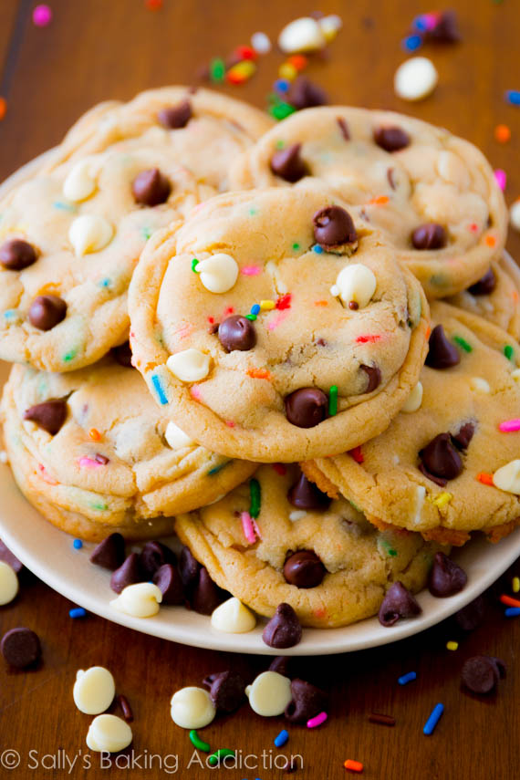
Working with proportions – Cookie recipe
2 ¼ cups all-purpose flour
1 teaspoon baking soda
½ teaspoon salt
1 cup butter, softened
¾ cup granulated sugar
¾ cup packed brown sugar
1 egg
1 teaspoon vanilla
2 cups semisweet chocolate chips
1 cup coarsely chopped nuts, if desired
Yields 48 cookies
How much flour would I need to bake 125 cookies?
(assume all other ingredients are on hand)
? Flour = 125 cookies X 2.25 cup flour
48 cookies
= 5.859375 cups flour
= 5.86 cups flour
The conversion factor comes from the proportions in the recipe between flour and cookies RED
Complete recipe can be found here:
https://www.bettycrocker.com/recipes/ultimate-chocolate-chip-cookies/77c14e03-d8b0-4844-846d-f19304f61c57

Slide 4
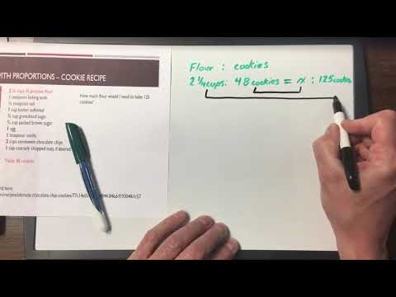
Working with Proportions – Cookie Recipe

Slide 5
Working with Proportions – Reaction equations
The proportions in a reaction equation come from the coefficients in the balanced equation. (the recipe)
C₃H₈ + 5O₂ → 3CO₂ + 4H₂O
1 molecule of propane reacts with 5 molecules of oxygen to produce 3 molecules of carbon dioxide and 4 molecules of water
10000 molecules + 50000 molecules → 30000 molecules + 40000 molecules (1:5:3:4)
1 mole + 5 mole → 3 mole + 4 mole (1:5:3:4 mole ratio)
Home much propane would be required to form 38 moles of water?
? Propane = 38 mole water X 1 mole propane
4 mole water
= 9.5 mole propane
The conversion fraction (ratio) comes from the coefficients of the balance reaction equation (the recipe)

Slide 6
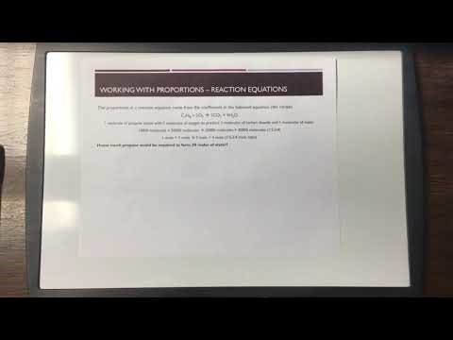
Working with Proportions - Reaction Equations

Slide 7
Practice
Read section7.1
Page 319 #1-3
Take the Check Your Understanding Quiz

