Slide 1
StoichiometrY – Mass to Mass
the quantitative study of reactants and products in a chemical reaction
Textbook Section 7.2

Slide 2
Mass to Mass Problems – Ketzbook (skip to 3:48 if you want to go directly to a chemistry problem)

Slide 3
Stoichiometry Problem solving process
I tend to apply a slightly different 5 step approach to solving these problems.
Start with a balance chemical reaction equation. The previous units of nomenclature and types of reactions will be very helpful here!
Using the equation as a organizational tool, record the given and required information below the substance that they are referring to.
Convert the given information into moles (your knowledge of mole conversions is important here n=m/M)
Using the coefficients from the balanced equation, apply the mole ratio between the given and required.
Convert the required number of moles to mass. (mole conversions again m=nM)
I will demonstrate how to apply this process to the same question previously solved in the Ketzbook video

Slide 4
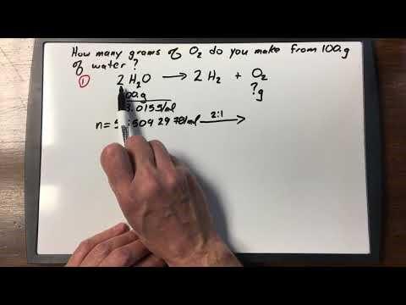
Stoichiometry problem solving process

Slide 5
Practice
Read section 7.2 (Figure 3 on page 322 is a nice visual summary of my process)
Complete page 323-324 #1-3
Complete problems from the 14-Stoichiometry Worksheet found on my website (do enough to be comfortable with the process, answers are given)
Complete the Check Your Understanding Quiz

