Slide 1
Stoichiometry – Limiting Reagent
the quantitative study of reactants and products in a chemical reaction
Textbook Section 7.3 & 7.4

Slide 2
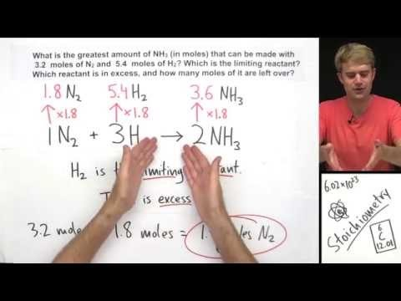
Limiting Reagent Problem – Tyler DeWit

Slide 3
Stoichiometry Problem Solving Process
Start with a balance chemical reaction equation. The previous units of nomenclature and types of reactions will be very helpful here!
Using the equation as a organizational tool, record the given and required information below the substance that they are referring to. (you will know that you have a limiting reagent problem if you have more than one given)
Convert the given information into moles (your knowledge of mole conversions is important here n=m/M)
Determine which reactant is the limiting reagent before proceeding to #4 (Tyler Dewitt uses the HAVE, NEED method which is fundamentally sound, I will show you a short cut to determining the limiting reagent)
Using the coefficients from the balanced equation, apply the mole ratio between the given and required.
Convert the required number of moles to mass. (mole conversions again m=nM)

Slide 4
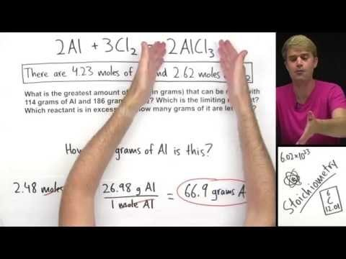
Limiting Reagent mass to mass calculation – Tyler Dewitt

Slide 5
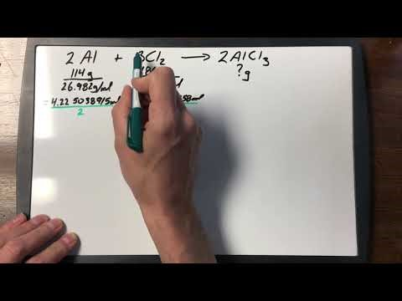
Limiting Reagent mass to mass Calculation

Slide 6
Practice
Read Sections 7.3 & 7.4
Page 330 #2, 4, 6
Page 332 #1-4
Page 334 #1-3
Complete problems from the 15-Limiting Reagent Problem found on my website (do enough to be comfortable with the process, full solutions are given)
Take the Check Your Understanding Quiz

