Slide 1
Stoichiometry – Percent Yield
the quantitative study of reactants and products in a chemical reaction
Textbook Section 7.5

Slide 2
Percent Yield
Percent Yield describes how much product was actually made in the lab versus the amount that theoretically could be made.
Actual Yield x 100 = Percent Yield
Theoretical Yield
Reactions do not always work perfectly. Experimental error (spills, contamination) often means that the amount of product made in the lab does not match the ideal amount that could have been made.
Theoretical Yield = The maximum amount of product that could be formed from given amounts of reactants. Calculated using STOICHIOMETRY.
Actual Yield = The amount of product actually formed or recovered when the reaction is carried out in the laboratory. Measured EXPERIMENTAL value.

Slide 3
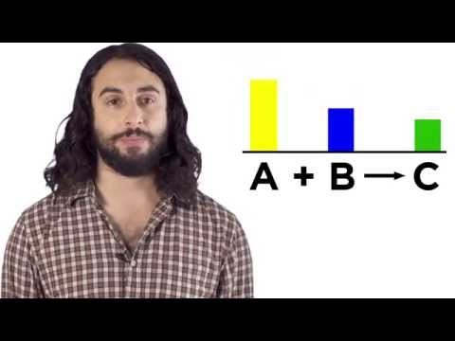
Percent Yield Calculation – Professor Dave Explains

Slide 4
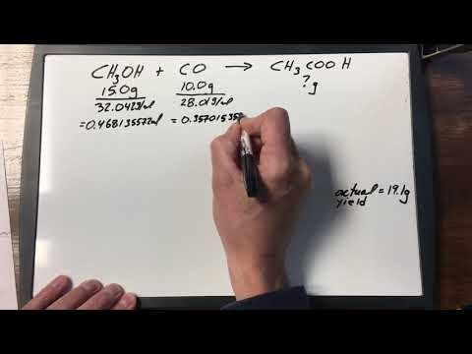
Checking Comprehension – Full Solution

Slide 5
Practice
Read through textbook section 7.5
Page 338 #1,2
Take the Check Your Understanding Quiz

