Slide 1
Atomic Radius

Slide 2
Atomic Radius
The average distance from the centre of the nucleus to the outer edge where electrons may be found.

Slide 3
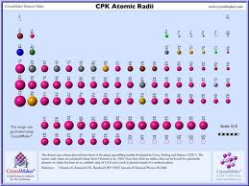
Models

Slide 4
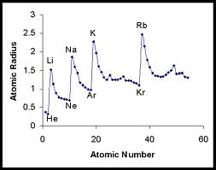
Graphing

Slide 5
1) As you move down a group, atomic radius increases
WHY? - The number of energy levels increases as you move down a group as the number of electrons increases. Each subsequent energy level is further from the nucleus than the last. Therefore, the atomic radius increases as the group and energy levels increase.

Slide 6
2) As you move across a period, atomic radius decreases.
WHY? - As you go across a period, electrons are added to the same energy level. At the same time, protons are being added to the nucleus. The concentration of more protons in the nucleus creates a "higher effective nuclear charge." In other words, there is a stronger force of attraction pulling the electrons closer to the nucleus resulting in a smaller atomic radius.

