Slide 1
History of The Atomic Theory
From Democritus to now…

Slide 2
Democritus ~ 400BC
a Greek philosopher, proposed that matter was made up of small, hard, indivisible particles, which he called atoms.
Democritus offered no real evidence to support his idea, and it was not widely believed

Slide 3
John Dalton ~ 1808
Modern atomic theory
Matter is composed of tiny indivisible particles called atoms.
All atoms of the one element are identical but are different from the atoms of other elements.
Chemical reactions consist of rearranging atoms in simple whole number ratios.

Slide 4
J.J. Thomson ~ 1904
Discovered the electron while experimenting with a cathode ray tube.
Proposed the "Plum Pudding" model of the divisible atom
Atoms consist of a large sphere of uniform positive charge embedded with smaller negatively charged particles (corpuscles).
The total positive charge of the sphere equals the total negative charge of the corpuscles.

Slide 5
Ernest Rutherford ~ 1911
Proposed a nuclear model of the atom in which:
a very small positively charged nucleus containing most of the mass of the atom
a very large volume around the nucleus in which electrons move
a nucleus containing positively charged protons
a number of protons equal to the number of electrons
He later proposed the existence of a neutral particle in the nucleus to make up for the calculated mass deficiency in the atoms studied.

Slide 6
Niels Bohr ~ 1913
Proposed a 'planetary' model for the hydrogen atom:
Electrons move around the nucleus in fixed orbits (like planets around the sun). An electron in a particular orbit has constant energy.
An electron can absorb energy and move to a higher energy orbit of larger radius. (excited electrons)
An excited electron can fall back to its original orbit by emitting energy as radiation.
Electrons can only exist in certain discrete energy levels.

Slide 7
Bohr’s Evidence
Emission spectra of hydrogen:
Lyman Series (ultraviolet) - corresponds to excited electrons falling back to the lowest energy level (smallest orbit) known as the ground state.
Balmer Series (visible) - corresponds to excited electrons falling from higher energy levels to the first excited level.
Paschen and Brackett Series (infrared) - excited electrons falling back to the 2nd, 3rd, 4th energy levels.

Slide 8
James Chadwick ~ 1932
The nucleus of an atom contains neutrons, electrically neutral particles with a mass similar to that of a proton.
Bombarded beryllium with alpha particles and discovered Rutherford's missing neutral particles.
The discovery of neutrons explained the existence of isotopes, first observed in 1920 by Francis Aston when he invented the mass spectrograph.

Slide 9
Quantum Mechanical Model of the Atom
Electrons occupy orbitals, volumes of space around the nucleus with a high probability of finding the electron.
Energy levels are made up of energy sublevels.
Each sublevel contains a set of orbitals.
No orbital can contain more than 2 electrons (Pauli Exclusion Principle).

Slide 10
Heisenberg Uncertainty Principle ~ 1924
Since an electron is so small, anything used to detect it’s location will push it away from where it was.
It is impossible to know the exact location of an electron at any time.
Any attempt to describe the position must involve a certain degree of uncertainty.

Slide 11
Erwin Schrodinger ~ 1926 The Wave Equation
When the equation is solved, it indicates the probability of finding an electron in a certain space about the nucleus.
These regions in space where an electron is most likely found are called orbitals.
In solving the wave equation 4 parameters were necessary.
These variables are called the Quantum Numbers, each describing different properties of the electron.

Slide 12
The Principal Quantum Number (n)
Used to describe the energy of the electron.
Same as the “old” energy levels in the Bohr model.
The lower the value of ‘n’, the lower the energy and the closer it is to the nucleus.
The value of ‘n’ is any integral number larger than zero.
n = 1,2,3,4,….

Slide 13
The Orbital Quantum Number (l)
Describes the shape of the electron probability distribution.
The value of ‘l’ depends on the value of ‘n’.
There are always n values of ‘l’
For each n value l starts at 0 to a maximum of n-1
When n=1, l=0 (there is only one sub-level)
When n=2, l=0,1 (there are two sub-levels)
When n=3, l=0,1,2 (three sub-levels)

Slide 14
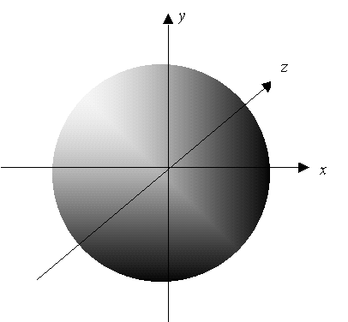
Orbital Shapes
When l=0 the probability distribution looks spherical.

Slide 15
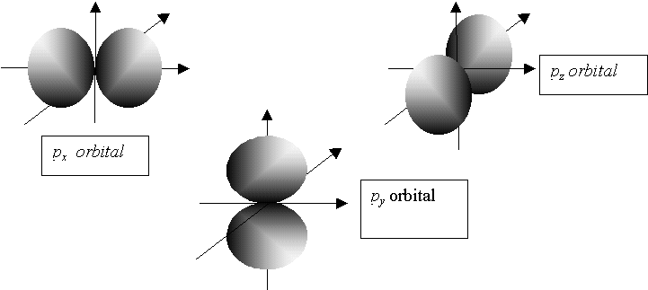
Orbital Shapes
When l=1 the probability distribution looks like propellers

Slide 16
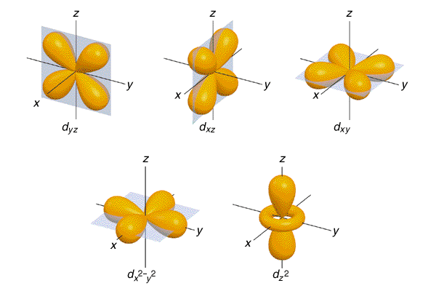
Orbital Shapes
When l=2 the probability distribution looks really weird.

Slide 17
Magnetic Quantum Number (m_{l})
This number describes the orientation of the probability distribution on 3D.
The value of ‘m_{l}’ depends on the value of ‘l’
-l ≤ m_{l} ≤ l
When l=0, m_{l} = 0
When l=1, m_{l} = -1,0,1
When l=2, m_{l} = -2,-1,0,1,2

Slide 18
Spin Quantum Number (m_{s})
Refers to the spin of the electron.
Each electron can spin on it’s axis creating a magnetic field.
The value of m_{s} is either +½ or -½, relating to either a clockwise or counter-clockwise spin.

Slide 19
Pauli Exclusion Principle
No two electrons in any atom can have the same set of four quantum numbers.
What this means is that since the 4 quantum numbers describes the probable location of an electron around an atom, no two electrons can occupy the same place at the same time, therefore they must have a unique set of quantum numbers.

Slide 20
Hydrogen
What 4 quantum numbers would be used to describe the position of the only electron around hydrogen?

