Slide 1
Collision Theory
Rates of reactions

Slide 2
Collision Theory
If you have a situation involving two species they can only react with each other if they come into contact with each other. They first have to collide, and then they may react.
Why "may react"? It isn't enough for the two species to collide.
They have to collide the right way around, and they have to collide with enough energy for bonds to break.

Slide 3
Only 2 at a time…
The chances of all this happening if your reaction needed a collision involving more than 2 particles are remote.
All three (or more) particles would have to arrive at exactly the same place at the same time, with everything lined up exactly right, and having enough energy to react.
That's not likely to happen very often!

Slide 4
The orientation of collision
Consider a simple reaction involving a collision between two molecules - ethene and hydrogen chloride.
As a result of the collision between the two molecules, the double bond between the two carbons is converted into a single bond. A hydrogen atom gets attached to one of the carbons and a chlorine atom to the other.
How many different orientations are possible for this collision?

Slide 5
The reaction can only happen if the hydrogen end of the H-Cl bond approaches the carbon-carbon double bond. Any other collision between the two molecules doesn't work. The two simply bounce off each other.
Why?

Slide 6
The energy of the collision Activation Energy
Even if the species are orientated properly, you still won't get a reaction unless the particles collide with a certain minimum energy called the activation energy of the reaction.

Slide 7
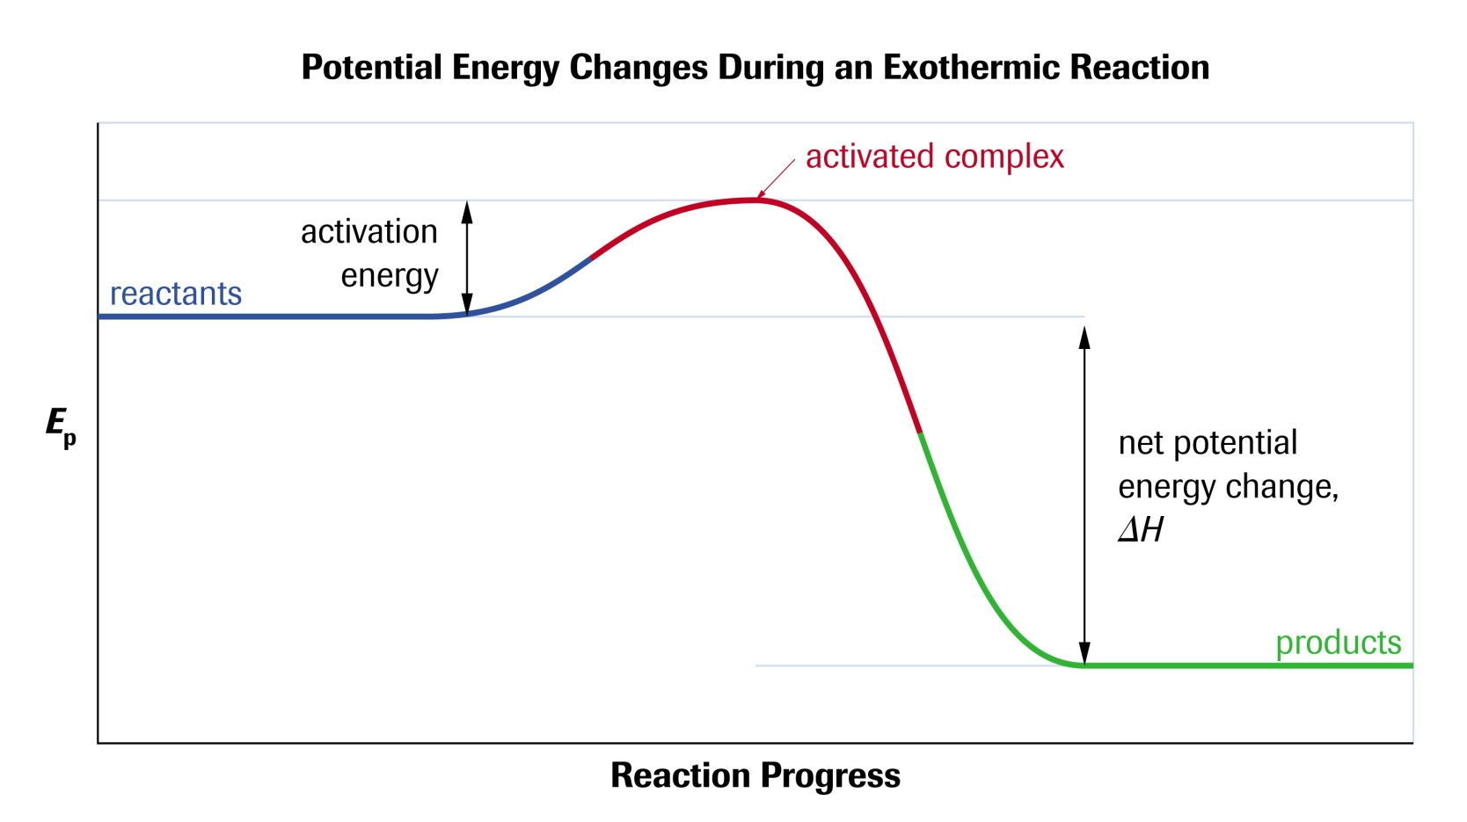
Activation energy is the minimum energy required to break some bonds and create an “activated complex”. For a simple over-all exothermic reaction, the energy profile looks like this:

Slide 8
If the particles collide with less energy than the activation energy, nothing important happens, they bounce apart. Only those collisions which have energies equal to or greater than the activation energy result in a reaction.
Some bonds have to be broken before new ones can be made. Activation energy is involved in breaking some of the original bonds.
Where collisions are relatively gentle, there isn't enough energy available to start the bond-breaking process, and so the particles don't react.

Slide 9
The Maxwell-Boltzmann Distribution
It would be useful to know what proportion of the particles present have high enough energies to react when they collide. (Activation Energy)
In any system, the particles present will have a very wide range of energies. For gases, this can be shown on a graph called the Maxwell-Boltzmann Distribution which is a plot of the number of particles having particular energy.

Slide 10
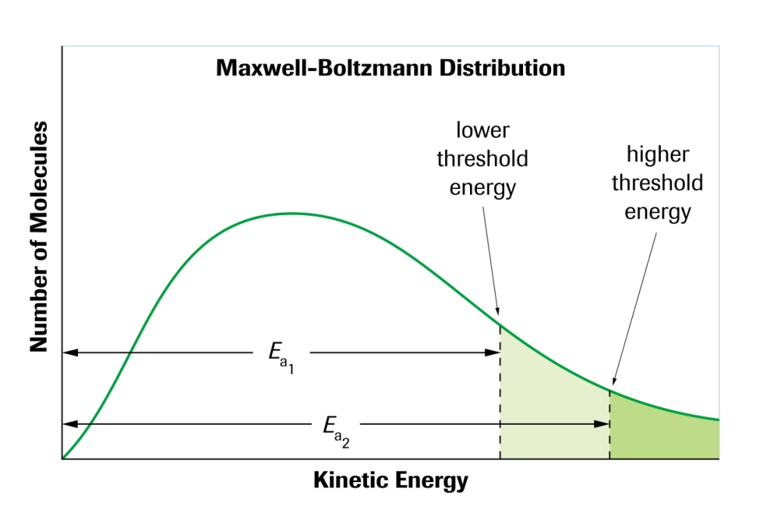
The Maxwell-Boltzmann Distribution and activation energy
For a reaction to happen, particles must collide with energies equal to or greater than the activation energy for the reaction. We can mark the activation energy on the Maxwell-Boltzmann distribution:

Slide 11
Notice that the large majority of the particles don't have enough energy to react when they collide. To enable them to react we either have to change the shape of the curve, or move the activation energy further to the left.
How can this be done? Let’s look at factors affecting rates of reactions.

Slide 12
Factors Affecting Rates of Reaction

Slide 13
1. Temperature
When two chemicals react, their molecules have to collide with each other with sufficient energy for the reaction to take place.
The two molecules will only react if they have enough energy.

Slide 14
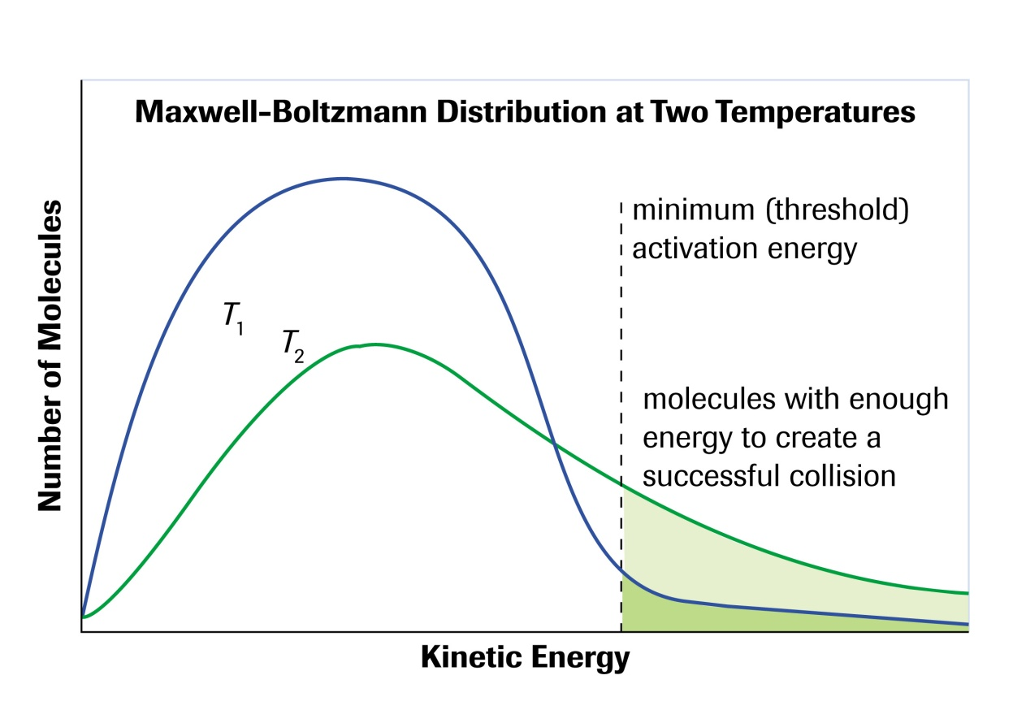
1. Temperature
By heating the mixture, you will raise the energy levels of the molecules involved in the reaction and therefore change the shape of the Maxwell-Boltzman Distribution.

Slide 15
2. Concentration/pressure and surface Area
If the concentration or pressure of a chemical increases, there will be more particles within a given space.
Particles will therefore collide more often resulting in more overall collisions.
If the total number of collisions increases the number of effective collisions (proper orientation and energy) should also increase proportionally.

Slide 16
3. Physical state
If particles are in the same phase (homogeneous), then it is very easy for them to mix with each other. This gives particles the maximum opportunity to collide.
BUT, if the reactants are in different phases (heterogeneous), then the reaction can only take place on the interface of the two substances.
The smaller the size of the solid particles, the greater the area that the reaction can take place in, so finely divided powder reacts more quickly than the same stuff in a great big lump!

Slide 17
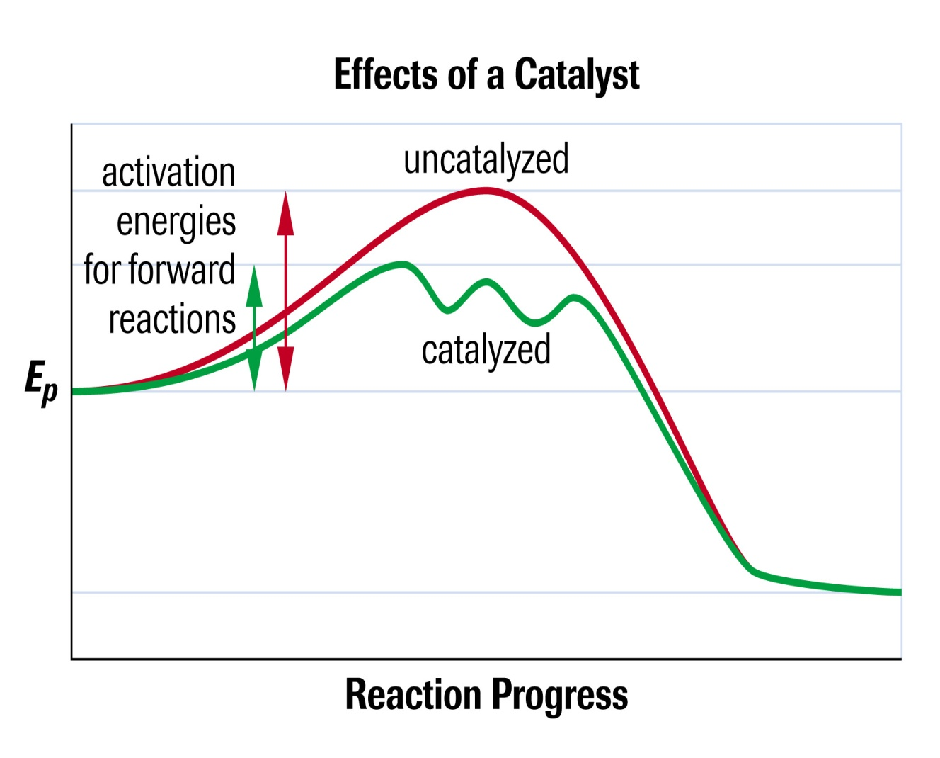
4. Catalyst
What is a catalyst?
A catalyst is a substance that alters the rate of a chemical reaction without being used up or permanently changed chemically.
It provides an alternative route (mechanism) that lowers the Activation Energy meaning more particles now have the required energy needed to undergo a successful collision.

Slide 18
Homework
Read Sections 6.2 and 6.3
Page 365 #1,5
Page 372 #1,2

