Slide 1
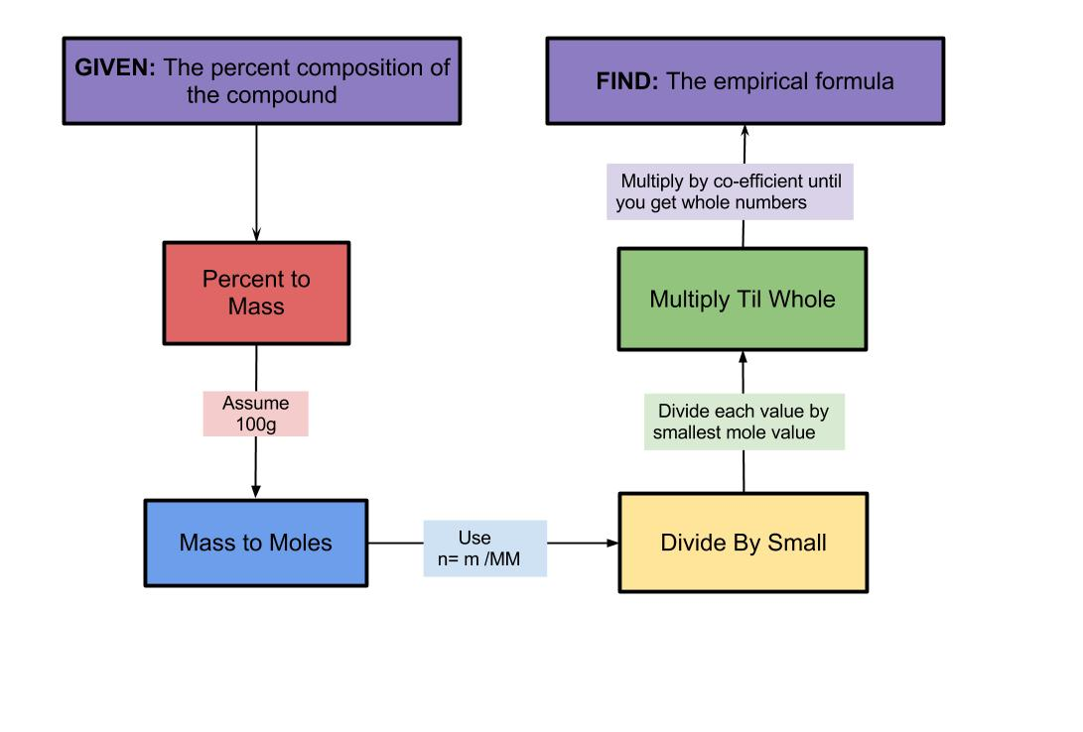
Empirical Formula

Slide 2
Empirical Formula
the empirical formula of a chemical compound is the simplest whole number ratio of atoms of each element present in a compound.
The empirical formula is used as standard for most ionic compounds, such as CaCl₂
The molecular formula identifies the number of each type of atom in a molecule, and the structural formula also shows the structure of the molecule.

Slide 3
Empirical vs. Chemical Formula
The chemical compound n-hexane has the structural formula CH₃CH₂CH₂CH₂CH₂CH₃, which shows that it has 6 carbon atoms arranged in a straight chain, and 14 hydrogen atoms.
Hexane's molecular formula is C₆H₁₄, and its empirical formula is C₃H₇, showing a C:H ratio of 3:7.

Slide 4
Calculating Empirical Formula
Start with the number of grams of each element, given in the problem. If percentages are given, assume that the total mass is 100 grams. Why assume 100g sample?
Convert the mass of each element to moles using the molar mass from the periodic table. n=m/M
Divide each mole value by the smallest number of moles calculated.
Round to the nearest whole number. This is the mole ratio of the elements and is represented by subscripts in the empirical formula.
If the number is too far to round (x.1 ~ x.9), then multiply each solution by the same factor to get the lowest whole number multiple. See page 291.

Slide 6
Sample Problem #1
A compound was analyzed and found to contain 13.5g Ca, 10.8g O, and 0.675g H. What is the empirical formula of the compound?

Slide 7
Answer

Slide 8
Sample Problem #2
NutraSweet is 57.14% C, 6.16% H, 9.52% N, and 27.18% O. Calculate the empirical formula of NutraSweet.

Slide 9
Answer
C₁₄H₁₈N₂O₅
This is the empirical formula, not the chemical formula of NutraSweet.
What is the chemical formula for NutraSweet?

Slide 10
Homework
Pg 292 #1
Pg 293 #4,9

