Slide 1
Enthalpy

Slide 2
Enthalpy
Enthalpy (H)is the total amount of energy contained within a substance. Included all forms of energy, kinetic, potential…
Very difficult to measure all forms of energy within a substance, therefore a change in enthalpies is measured whenever a change occurs.
∆H = difference in enthalpies as a chemical system changes.(reactants → products)

Slide 3
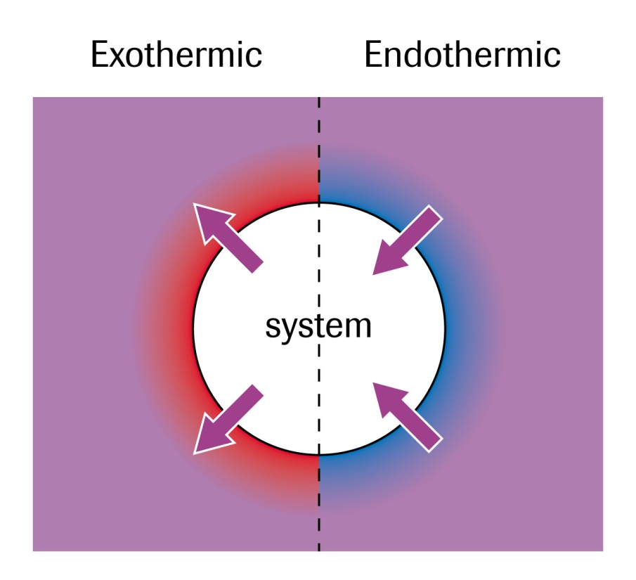
Enthalpy Changes
By convension:
∆H = (-) for exothermic
∆H = (+) for endothermic

Slide 4
Measuring Enthalpy Changes
Calorimetry can be used to measure enthalpy changes.
If the change in energy of the surroundings can be measured, according to the law of conservation of energy, the systems energy must be equal and opposite.
∆H_{system} = -q_{surroundings}

Slide 5
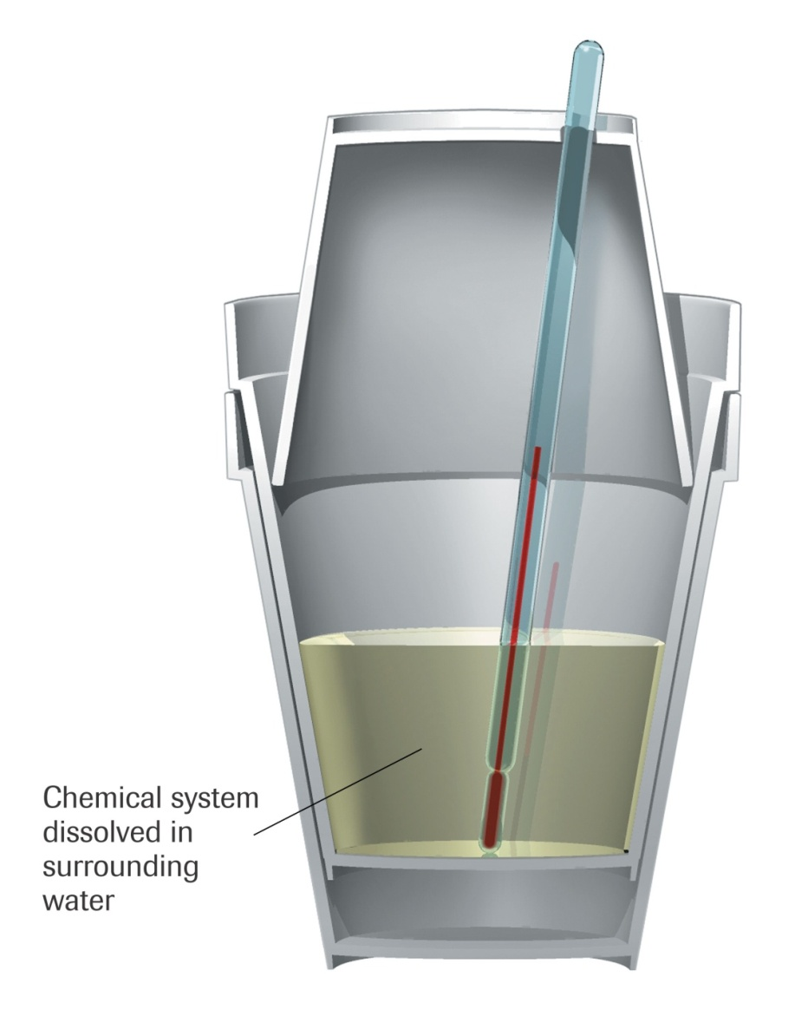
Enthalpy of Changes
An isolated system is desired so that the energy of the chemical system and the surroundings is not lost.
A calorimeter is used to perform calorimetry.
A coffee cup calorimeter is used to measure the heat exchanged when substances react in the liquid phase.

Slide 6
Calorimetry
Assumptions:
No heat is transferred between the calorimeter and the outside environment (isolated)
Any heat absorbed/released by the calorimeter is negligible.
Dilute solutions are assumed to have a density and specific heat capacity of pure water.
∆H_{system} = - q_{surroundings}

Slide 7
Sample Problem
What is the molar enthalpy of solution (dissolving process) of potassium chloride if dissolving a 7.46g sample into 100.0ml of water causes the water to change from 24.1ºC to 20.0ºC?

Slide 8
∆H_{sol(KCl)} = +1.7 x 10⁴ J/mol
Or
∆H_{sol(KCl)} = +17 kJ/mol

Slide 9
Enthalpy Changes
Since there are many different types of changes that can be measured, a subscript is used to indicate which type of change is occuring. (see page 299)
∆H_{x} where x represents the type of change for 1 mol of the substance.

Slide 10
Molar Enthapy
The enthalpy change associated with a physical, chemical or nuclear change of one mole of a substance.
H₂ + ½ O₂ → H₂O + 241.8kJ
∆H_{comb} = -241.8 kJ/mol
How much energy would be released if 2.0 mol of hydrogen were burned?

Slide 11
Molar Enthalpy
∆H = n ∆H_{x}
Recall: n = m/M
How much energy would it require to convert 26.7g of methanol from liquid to gas?
Calculate the moles of methanol.
Look up the molar enthalpy of vapourization of methanol (page 307)

Slide 12
Homework
Pg 301 #1-4

