Slide 1
Hybrid Orbital Theory
The next frontier

Slide 2
The Extension of Valence Bond Theory
Valence Bond theory does a good job in explaining which orbitals are involved in bonding.
The break down comes when we try to explain molecular shape.
Water, according to VBT should have a 90º bond angle, in reality, the bond is closer to 104º.

Slide 3
Hybridization of Orbitals
Hybridization is not a physical phenomenon; it is merely a mathematical operation that combines the atomic orbitals we are familiar with in such a way that the new (hybrid) orbitals possess the geometric and other properties that are reasonably consistent with what we observe in a wide range (but certainly not in all) molecules.

Slide 4
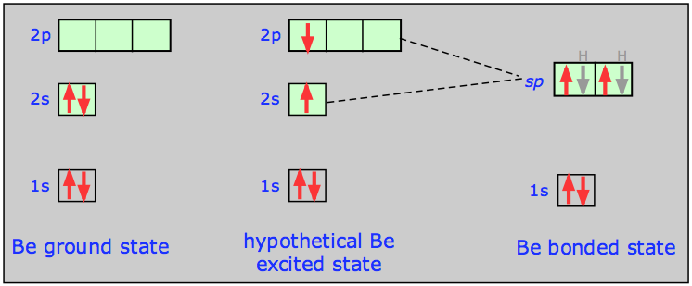
Linear Molecules – sp orbitals
The ‘s’ electron is promoted into one of the empty ‘p’ orbitals. These two orbitals ‘blend’ together to create 2 half filled ‘sp’ orbitals, orientated at 180º from one another for the purpose of bonding.

Slide 5
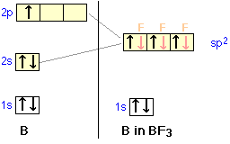
Trigonal molecules - sp² orbitals
In a molecule such as BF₃, 3 half filled orbitals are needed. Once again, one of the ‘s’ electrons is promoted into an empty ‘p’ and the 3 orbitals are blended to create 3 half filled sp² orbitals for the purpose of bonding.
These orbitals arrange themselves as far apart as possible at take the corner positions of an equilateral triangle with a bond angle of 120º.

Slide 6
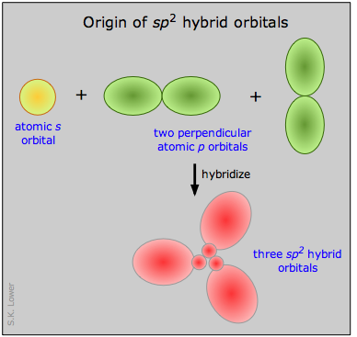
sp² hybridization

Slide 7
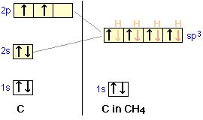
Tetrahedral Molecules – sp³ orbitals
CH₄ requires 4 half filled orbitals. The half filled s and 3p orbitals blend to create 4 sp³ orbitals.
The orbitals align themselves at the corners of a tetrahedral, having a bond angle of about 109.5º

Slide 8
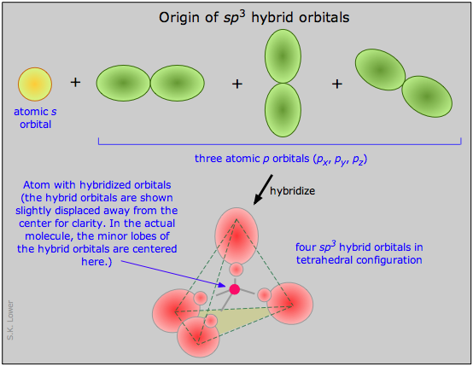
sp³ hybridization

Slide 9
Extention
It is possible to extend this idea to predict how 5 or even 6 hybrid orbitals can be formed by including ‘d’ orbitals for any element beyond the 2nd period.
sp³d – 5 bonding orbitals
sp³d² – 6 bonding orbitals

Slide 10
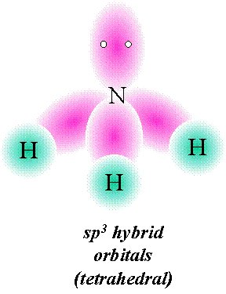
Lone Pairs
If lone pair electrons are present on the central atom, these can occupy one or more of the hybrid orbitals.
Lets look at ammonia – NH₃

Slide 11
References
http://www.chem1.com/acad/webtext/chembond/cb06.html#SEC2

