Slide 1
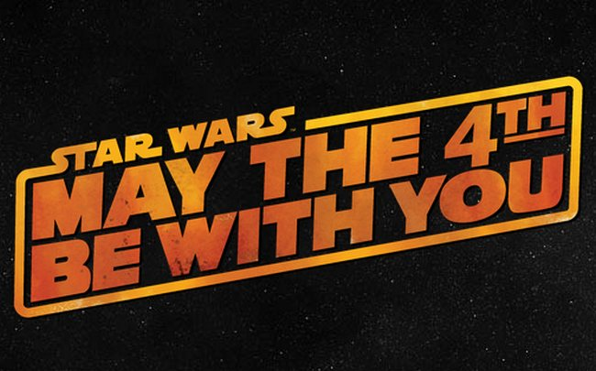

Slide 2
In the Force Awakens, which character has Darth Vader’s damaged mask?
A. Finn
B. Ray
C. Kylo Ren
D. Luke Skywalker

Slide 3
Correct Answer: Kylo Ren

Slide 4
While the Jedi use a number of different crystal colours for their lightsabers, what colour is preferred by the Sith?
A. Purple
B. Blue
C. Red
D. Green

Slide 5
Correct answer: Red

Slide 6
Where does Yoda live when he first trains Luke Skywalker?
A. Tatooine
B. Dagobah
C. Hoth
D. Coruscant

Slide 7
Correct Answer: Dagobah

Slide 8
When fighting his own father in the Cloud City, which hand does Luke Skywalker lose?
A. Right
B. Left
C. Both
D. Neither

Slide 9
Correct Answer: Right

Slide 10
What are the creatures, living on Endor, that help the Rebel’s to defeat the second Death Star?
A. Ewoks
B. Nerf Herders
C. Wookies
D. Jawas

Slide 11
Correct Answer: Ewoks

Slide 12
What nickname does Han Solo call Luke Skywalker that drives him crazy?
A. Buckaroo
B. Kid
C. Skydancer
D. Lukie

Slide 13
Correct answer: Kid

Slide 14
Who delivers the final blow that destroys the second Death Star?
A. Han Solo with an X-Wing
B. Luke Skywalker with a Speeder
C. Jar Jar Binks with a Y-Wing
D. Lando Calrissian with the Millennium Falcon

Slide 15
Correct Answer: Lando Calrissian

Slide 16
In Episode VI: Return of the Jedi, who says “A Jedi Knight? Jeez, I’m out of it for a little while, everyone gets delusions of grandeur!”
A. Han Solo
B. Chewie
C. Luke Skywalker
D. Lando Calrissian

Slide 17
Correct Answer: Han Solo

Slide 18
How many lightsaber blades does Darth Maul use?
A. 5
B. 4
C. 3
D. 2

Slide 19
Correct Answer: 2

Slide 20
In Episode V: The Empire Strikes Back, who said “Why, you stuck up, half-witted, scruffy-looking nerf herder!”
A. C-3PO
B. Luke Skywalker
C. Darth Vader
D. Princess Leia

Slide 21
Correct Answer: Princess Leia

Slide 22
Have a Great May the Fourth

