Slide 1
Measuring Rates of Reactions

Slide 2
Rates of Reaction
The rate of a chemical reaction is the speed at which the reaction occurs (i.e. speed at which the reactants are used or products are produced).
Rate can be measured by the:
1) change in mass of reactants or products.
2) change in pH
3) change in conductivity (ion production)
4) change in colour (intensity of colour)
5) change in temperature
6) production of a gas
The factors that will affect the rate of a reaction are:
1) Temperature
2) Surface Area
3) Concentration
4) Catalyst
5) Chemical Nature of Reactants
6) State of the Reactants

Slide 3
Chemical Reaction Rates
The reaction rates of chemical reactions are the amounts of a reactant reacted or the amount of a product formed per unit time, (moles per second). Often, the amount can be expressed in terms of concentrations.
A realistic representation for a reaction rate is the change in concentration per unit time, either the decrease of concentration per unit time of a reactant or the increase of concentration per unit time of a product. In this case, the rate is expressed in Mol/(L sec).

Slide 4
Measuring Reaction Rates
To measure a reaction rate, we usually monitor either a product or a reactant for its change.
Any physical characteristic related to the quantity or concentration of a product or reactant can be monitored.
Some of the characteristics to be monitored are: change in pressure change in color (spectroscopic measurement) temperature for exo or endothermic reaction presence of certain key substance

Slide 5
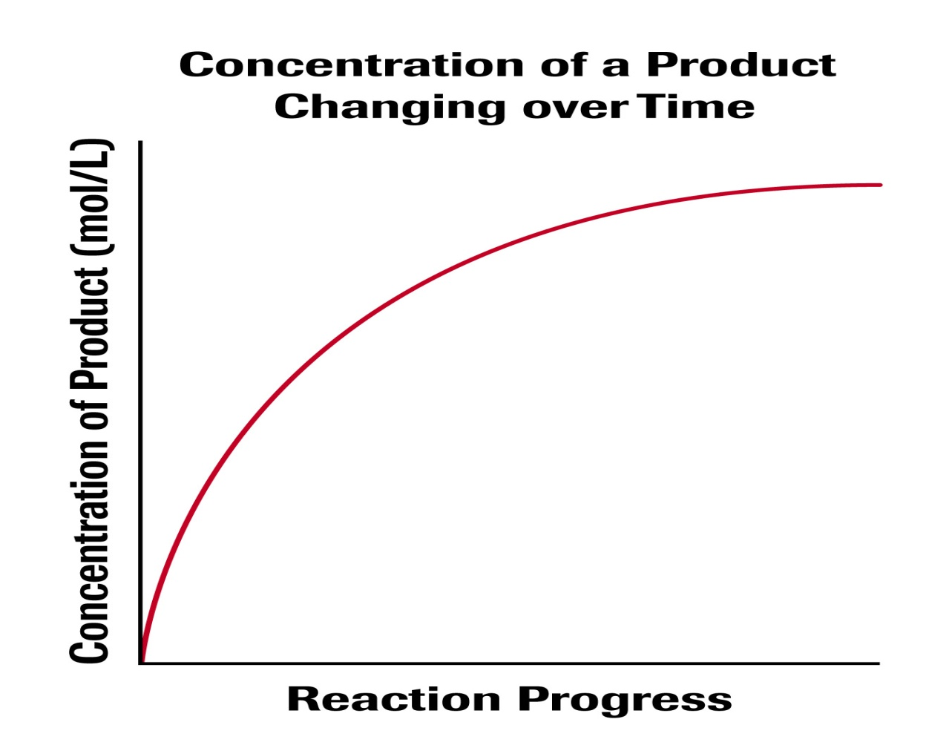
The change can be plotted on a graph, and from the graph, we can get the average rate or the instantaneous rate by graphical analysis.

Slide 6
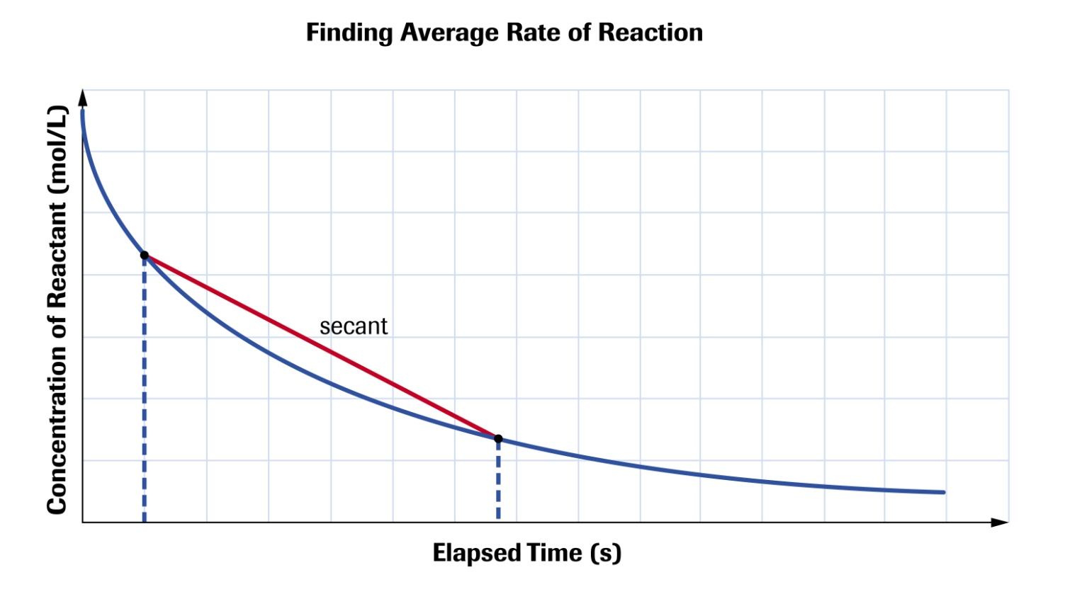
Average Rate
rate measured between long time interval (slope of secant)

Slide 7
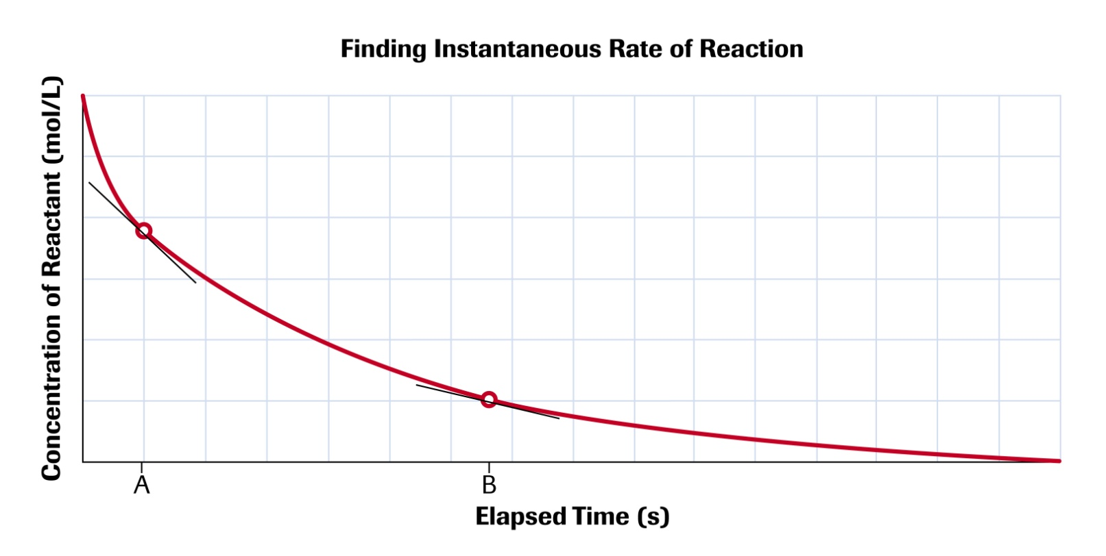
Instantaneous Rate
rate measured between very short interval (slope of tangent)

Slide 8
Practice
Read section 6.1
Page 350 #1
page 352 #1
Page 356#1,2
Page 360 #1,2

