Slide 1
Periodic Trends
Ionic Radius
Ionization Energy
Electron Affinity

Slide 2
Ionic Radius
The average distance from the centre of the nucleus to the outer edge where electrons may be found for an ION (charged atom)
Cation – a positive charged ion formed by the loss of one or more electrons
Anion – a negative charged ion formed by the addition of one or more electrons

Slide 3
Trend
In general all cations become smaller than their corresponding atom
In general all anions become larger than their corresponding atom.
Explain WHY using what we talked about yesterday.

Slide 4
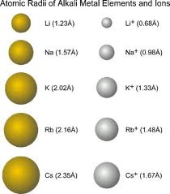
Cation
When an atom forms a positive ion, electrons are lost so that the atom has the same number of electrons as the closest Noble Gas. In doing so, an entire energy level is lost.
The force of attraction of the nucleus is now shared among fewer electrons and therefore stronger, resulting in a smaller radius.

Slide 5
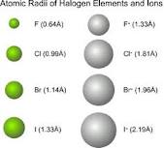
Anion
When an atom forms a negative ion, electrons are gained so that the atom has the same number of electrons as the closest Noble Gas.
The force of attraction of the nucleus is now shared among more electrons and therefore weaker, resulting in a larger radius.

Slide 6
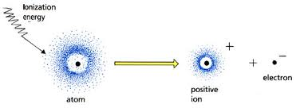
Ionization Energy
The quantity of energy required to remove an electron from an atom or ion in the gaseous state. (form a cation).
There may be more than one electron that can be removed so it is usually specified which electron is being removed. 1st IE is the energy required to remove the most loosely held electron. Etc.

Slide 7
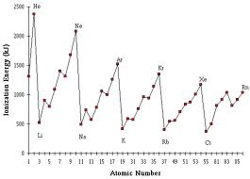
Trend in Ionization Energy
Using the graph, determine the trend for IE across a period as well as in a group. Explain why.

Slide 8
IE Trend Explained
As you move down a group, first ionization energy decreases. WHY? Electrons are further from the nucleus and thus easier to remove the outermost one. "SHIELDING" - Inner electrons at lower energy levels essentially block the protons' force of attraction toward the nucleus. It therefore becomes easier to remove the outer electron

Slide 9
IE Trend Explained
As you move across a period, first ionization energy increases. WHY? - As you move across a period, the atomic radius decreases, that is, the atom is smaller. The outer electrons are closer to the nucleus and more strongly attracted to the center. Therefore, it becomes more difficult to remove the outermost electron.

Slide 10
Second and Higher Ionization Energies
Definition: Second Ionization Energy is the energy required to remove a second outermost electron from a ground state atom. Subsequent ionization energies increase and become a maximum once an ion has reached the state like that of a noble gas. It becomes extremely difficult to remove an electron from an atom once it loses enough electrons to lose an entire energy level so that its valence shell is filled.

Slide 11
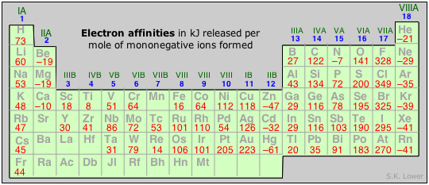
Electron Affinity
The energy change (energy released) that occurs when an electron is ADDED to a neutral atom in the gaseous state to form an anion.

Slide 12
EA Trend
Across a period the EA generally increases up to the Halogens and drops off significantly with the Noble Gases.
Down a group the EA generally decreases.

Slide 13
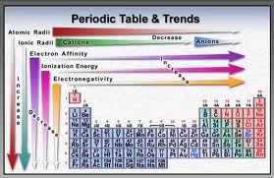
Summary of Increasing Trends

Slide 14
Homework
Read pages 36-41
Questions:
page 41 #1-6,8

