Slide 1
Representing Enthalpy Changes

Slide 2
Reaction Equation with Energy Term Included
The energy term can be included into a balanced chemical equation.
Reactants + Energy → Products (Endothermic)
Reactants → Products + Energy (Exothermic)
When included into the equation, energy is dealt with like any other substance (mole ratio).

Slide 3
Reaction Equation with ΔH Value
The energy term is listed without reference to any one substance or process, after the reaction equation.
Reactants → Products ΔH = (energy) kJ
Energy is not kJ/mol since it relates to the reaction as written.
ΔH = neg. for exothermic reactions
ΔH = pos. for endothermic reactions

Slide 4
Molar Enthalpy of Reaction
The energy is related to one mole of a substance undergoing a specific change.
The reaction equation is implied.
ΔH_{com pentane} = -2018 kJ/mol
C₅H₁₂ + 8O₂ → 5CO₂ + 6H₂O
(note only one mole of pentane)

Slide 5
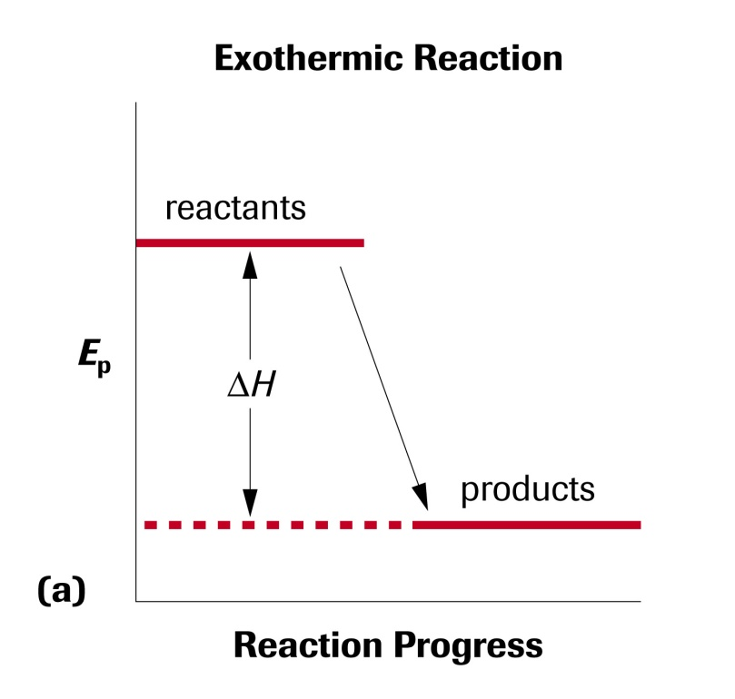
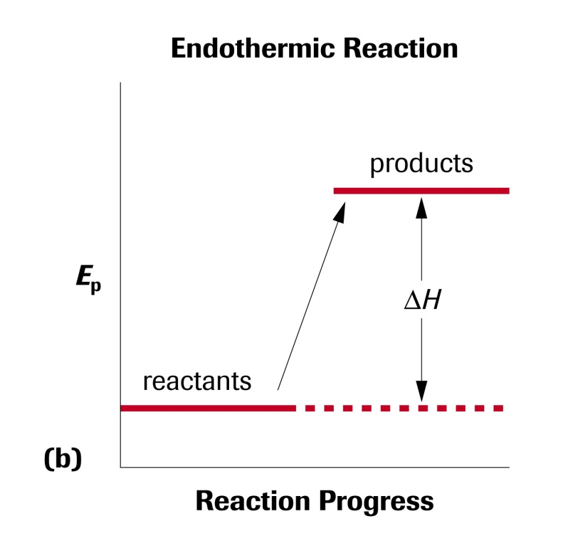
Potential Energy Diagrams
The reaction can be written in graphical form with energy plotted against the progress of the reaction.

Slide 6
Homework
Read section 5.2 (pages 301-306)
Page 304 #1-4
Page 306 #1-7

