Slide 1
Thermochemistry

Slide 2
Thermochemistry
Thermochemistry is the study of energy changes accompanying chemical and physical reactions.

Slide 3
Energy
Energy is the potential to do work, such as accelerating an object (kinetic energy), lifting things up (potential energy), produce electric power (electric energy), raising temperature of a system (heat) and producing sound (waves of energy).
Energy is the driving force of changes. All changes are caused by energy, and the cause or energy can be in many forms: light, heat, work, electrical, mechanical (energy stored in a spring), chemical, etc. The changes are phenomena caused by energy, but more importantly, forms of energy inter-convert into one another during the changes.

Slide 4
Conservation of Energy
Energy can neither be destroyed, nor created; it converts from one form (for example heat) to another form (say mechanical work) at a fixed rate. This is the fundamental principle of conservation of energy.

Slide 5
Chemical Systems
The substance undergoing a change is referred to as a chemical system.
The system’s environment is called the surroundings.

Slide 6
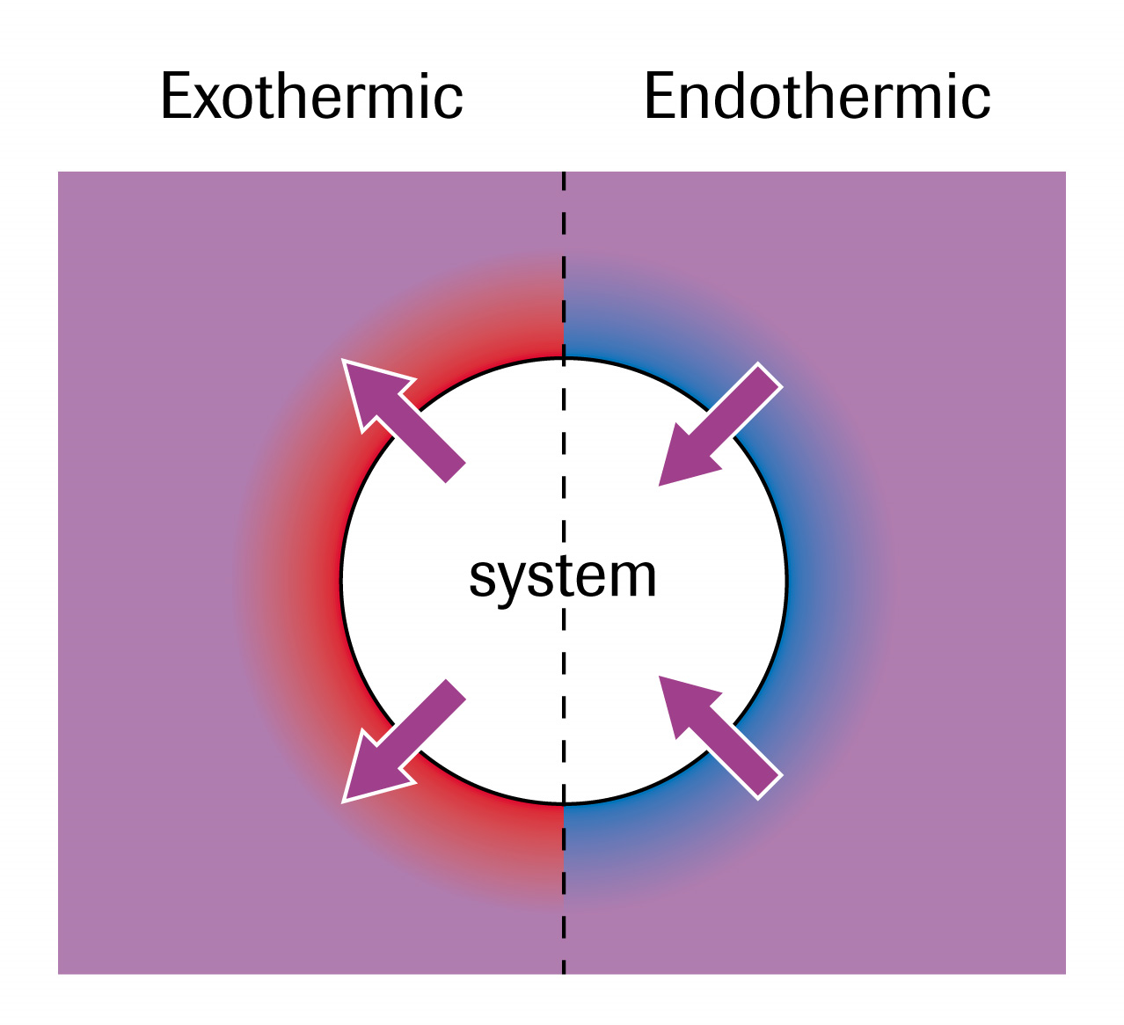
When the system transfers heat energy to the surroundings the change is classified as EXOTHERMIC.
When the surroundings transfers heat energy to the system the change is classified as ENDOTHERMIC.

Slide 7
Types of Systems
Open Systems – energy and matter are able to flow into and out of this type of system. (production of a gas)
Closed Systems – only energy can move in or out of the system but matter cannot. (most common)
Isolated System – an ideal system where neither matter nor energy can move in or out.

Slide 8
Measuring Energy Changes of Systems
Calorimetry – the indirect method of determining energy changes in a system by studying the surroundings.
There are 3 factors to consider when measuring heat absorbed or released.

Slide 9
1) The type of material. Different materials absorb/release energy differently. This is called the specific heat capacity of a substance. ‘c’ measured in Joules/gram ^{O}C.
2) The mass of the substance absorbing/releasing the energy. More substance requires more energy. Mass is measured in grams.
3) The change in the temperature of the substance. A greater change in temperature means a greater absorption/release of energy. ΔT = T₂ – T₁ can be measure in kelvin or ^{O}C.

Slide 10
Calorimetry Equation
q=mc ΔT
How much energy is absorbed by 300g of water if the temperature increases from 15 ^{O}C to 22 ^{O}C ?
If a 250g piece of iron changes temperature from 259 ^{O}C to 186 ^{O}C, how much energy was released?

Slide 11
Energy Changes
When q is a positive value, the energy has been absorbed by the substance.
When q is a negative value, the energy has been released by the substance.

Slide 12
Homework
Read section 5.1 and 5.2
Page 297 #1-3

